Slide 1
Utah’s Climate

Slide 2
Weather
The temperature/ precipitation during a short period of time

Slide 3
Climate
Weather Over Time

Slide 5
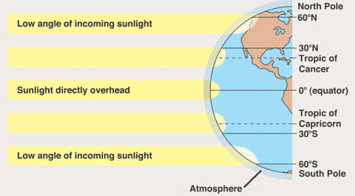
Three factors affect our climate
Latitude (how far north of the equator you’re at)
  Height of noonday sun & length of day = how much heat we get
  Closer to equator= hotter than places farther north

Slide 6
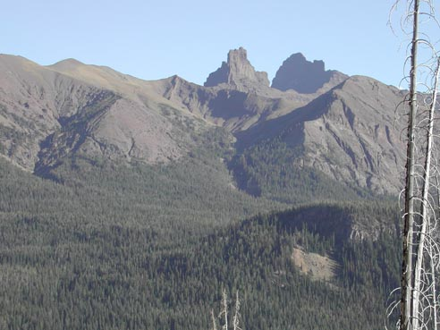
Elevation
  How high land is above sea level
  Air is cooler at higher elevations

Slide 7
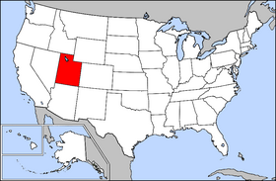
Distance from the Ocean
The closer you are to the ocean, the milder and wetter the climate is
Utah is far from an ocean so we have more extreme changes in temperature (4 very distinct seasons)

Slide 8
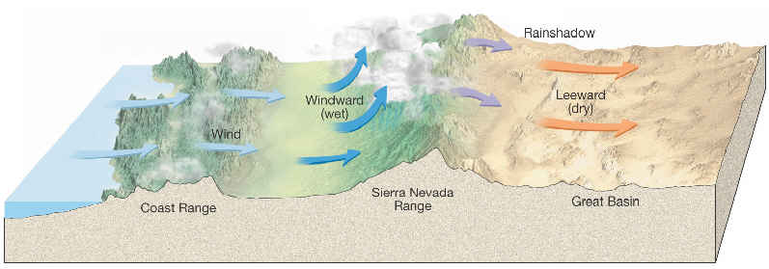
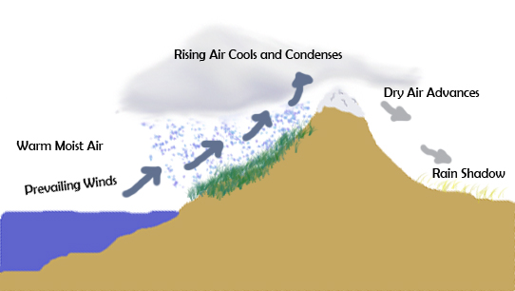
Landforms
(Rain Shadow Effect)

Slide 9
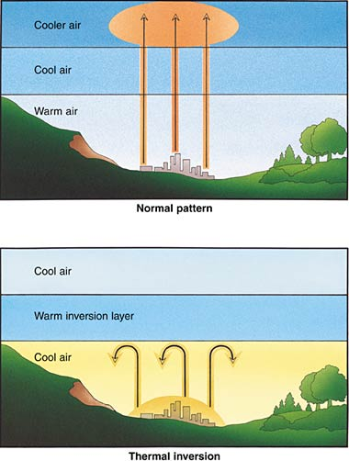
Inversion
How do Utah’s landforms contribute to our inversion problem?

Slide 10
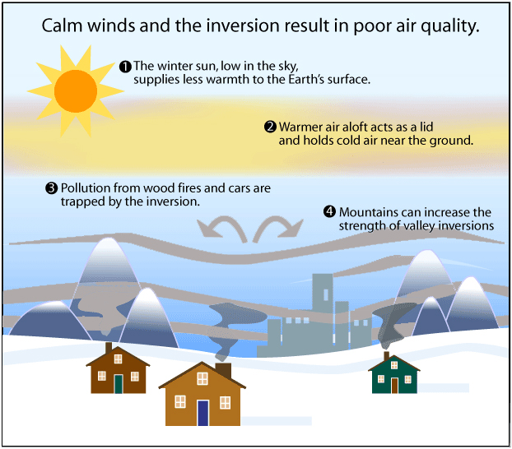
Inversion

Slide 11
How does climate affect people’s lives?
Clothing
Where we live
Recreation
Weather Phenomena:
  Flash floods/ Mudslides
  Drought (not enough water)
  Wild Fires
  Inversion (air pollution)
  Global Warming

