Slide 1
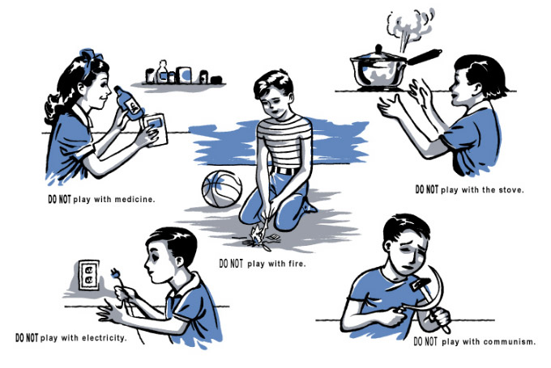

The Foundation of socialist government- The soviet model

Slide 2
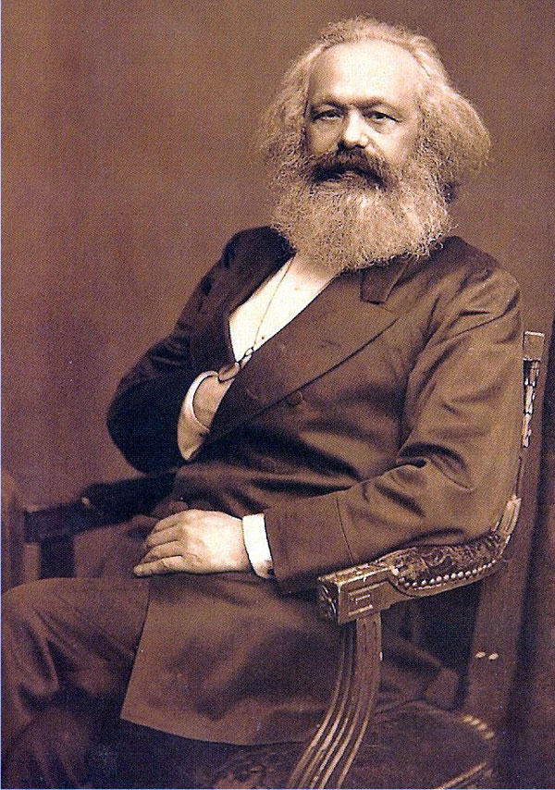
I. What is socialism
A. the system of socialism is where the government owns everything in order to promote equality
B. socialism arose as a response to very bad working conditions in the 1800’s
C. the communist manifesto was an essay written by Karl Marx promoting economic equality
D. socialism promotes economic equality for everybody in a society
E. most nations that rely mainly on socialism are pretty poor and have very low productivity levels (gdp)

Slide 3
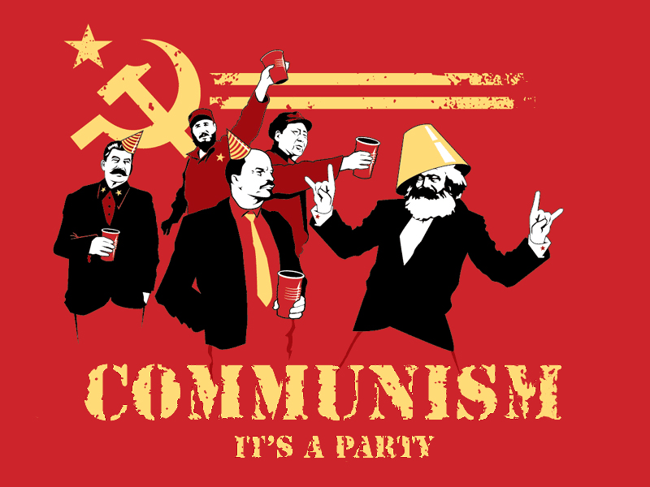
What is socialism?
F. socialism’s main principles include:
  1. no private property
  2. everyone is treated equally socially and financially
  3. at last people reach communism: this is the idea that there is no need for government since people know how to live with each other fairly and equally.

Slide 4
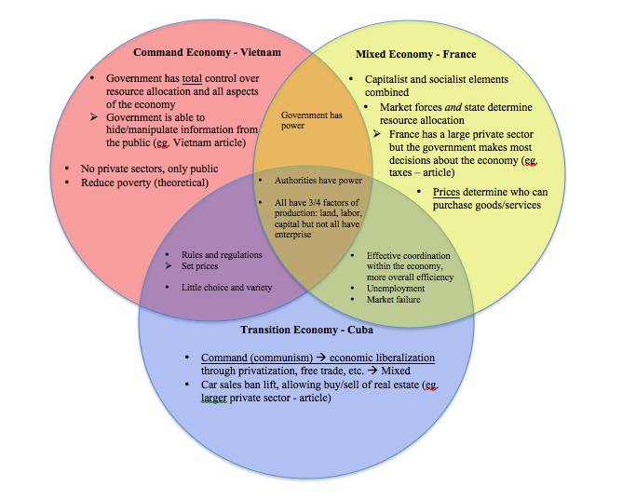
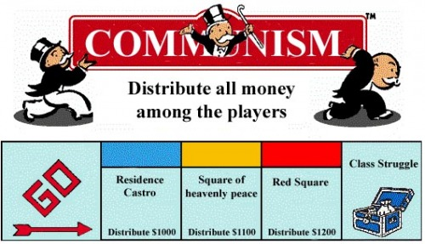
II. Variations of socialism in economics
A. in practice socialism has resulted in several very awful dictatorships such as soviet Russia and north Korea etc.
B. some promote a mixed economy which is a communist country that has a free market, parts of Europe have used this model
C. some support a command economy which is when the government determines your job and decides the price and supplement for everyone

Slide 5
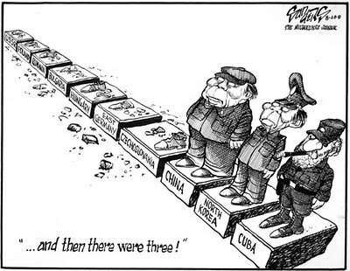
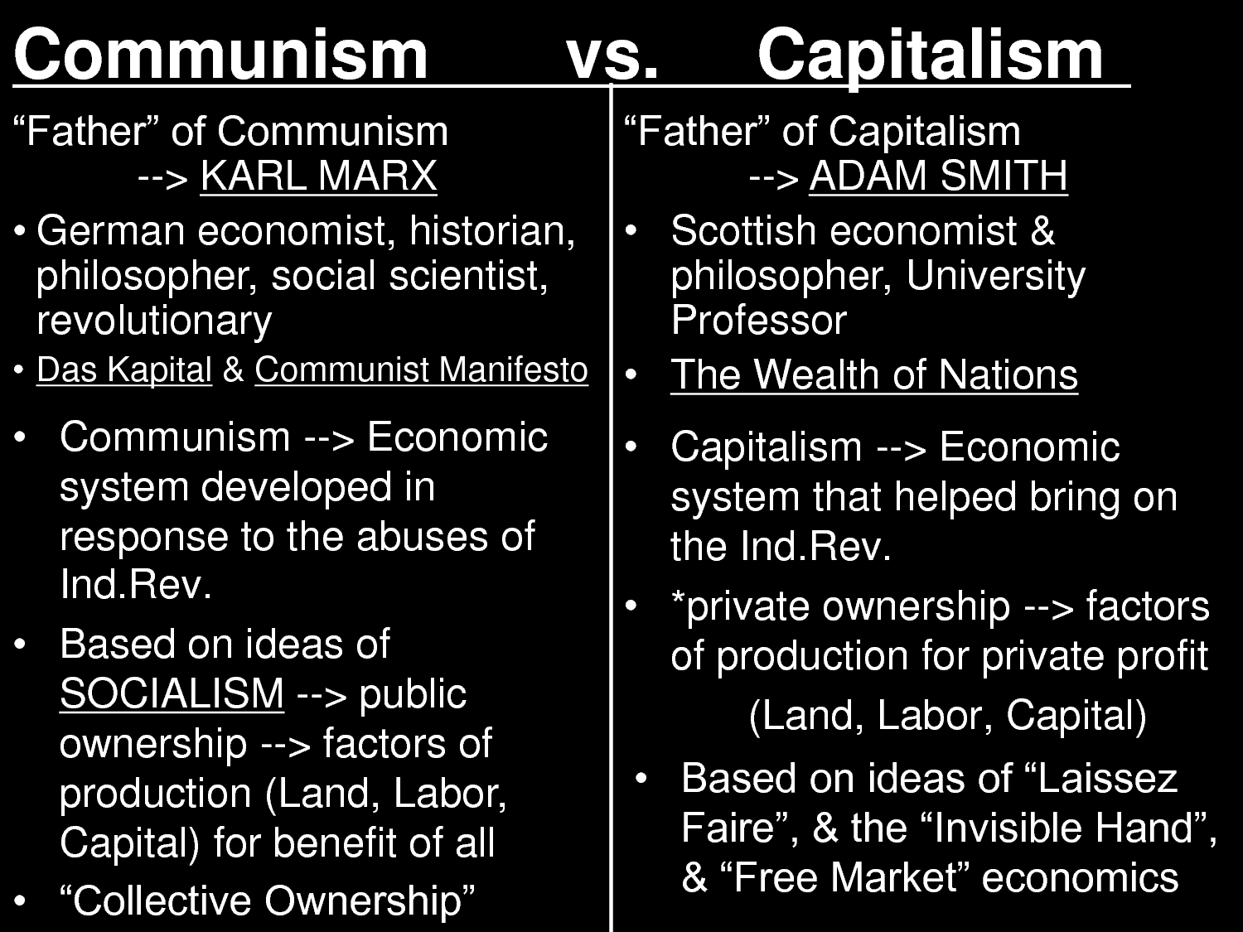
III. Advantages and disadvantages
A. advantages
  1. no social classes
  2. everyone gets their resources/needs
  3. in theory, no one will need government
B. disadvantages
  1. people tend to be lazy and not reach potential
  2. no personal freedoms
  3. economy is flat/stale

