Slide 1
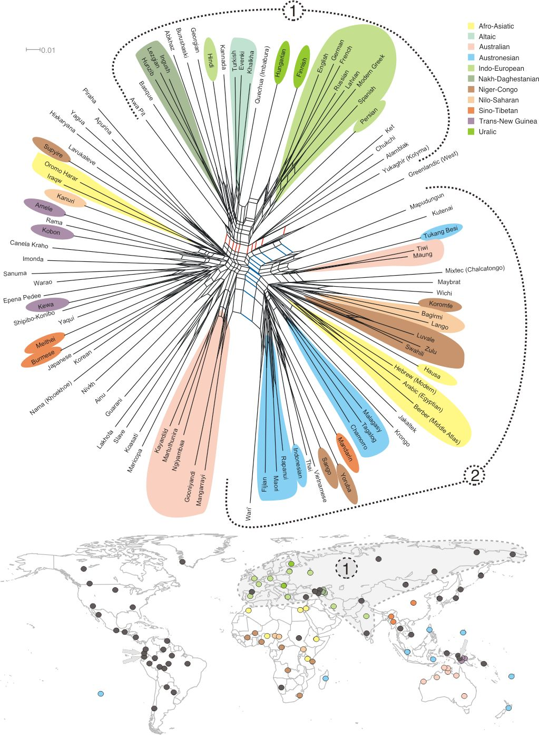
Language families, dialects, and linguistics

Slide 2
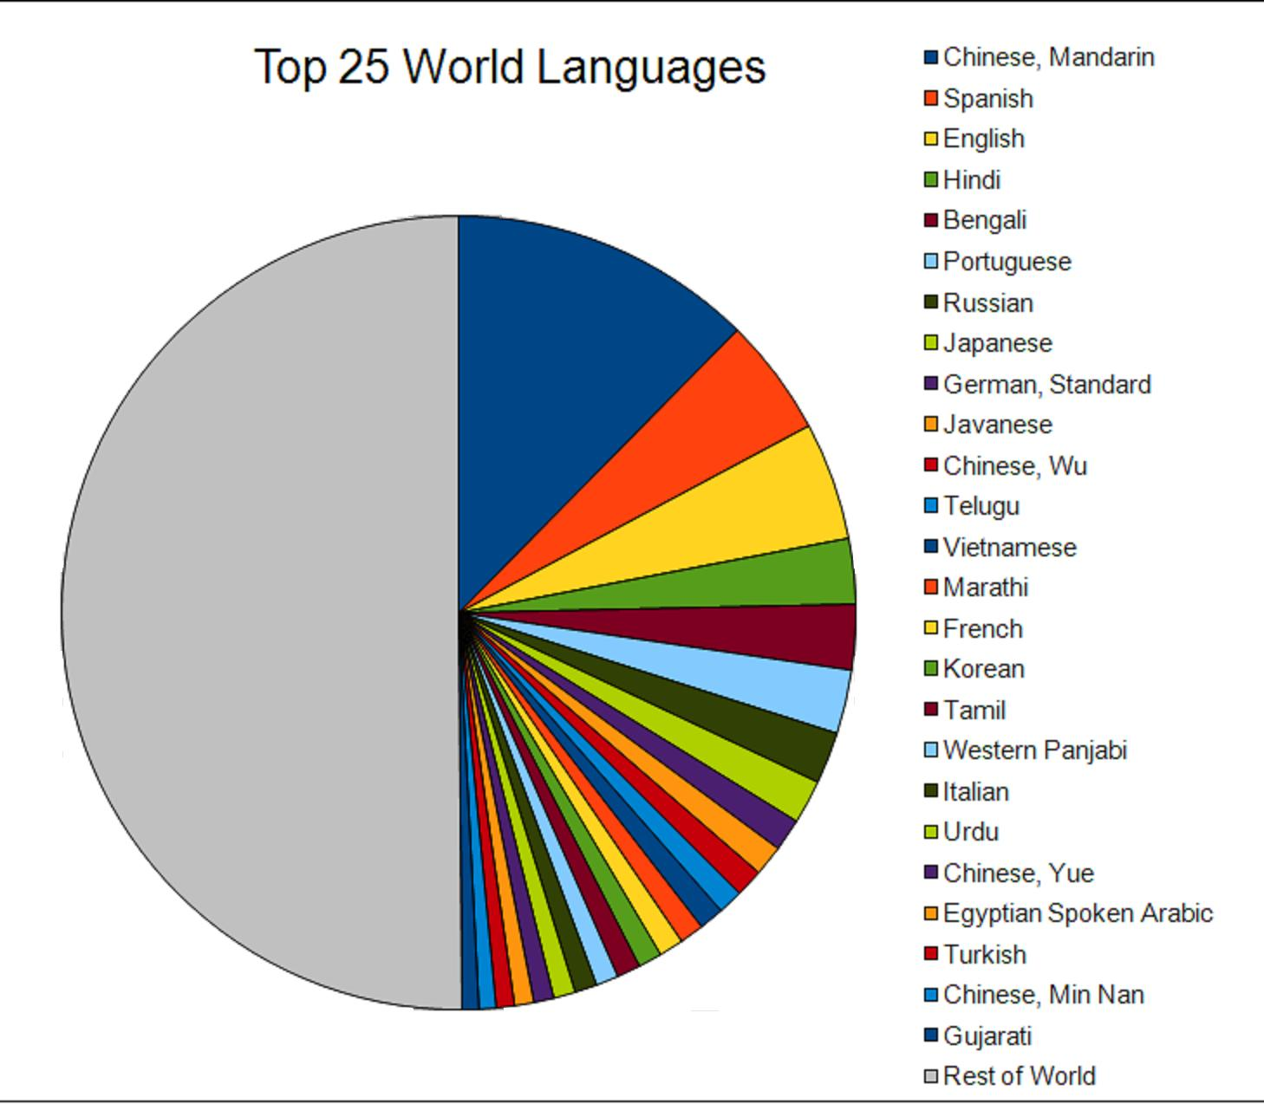
I. Language families and dialects
A. languages are the main form of communication for people.
  1. there are over 6800 distinct languages
  2. about 23 languages are written down
  3. mandarin Chinese has the most native speakers
  4. English is the largest overall spoken language
B. many places use creole or pidgin languages, 2 languages fused together (African, European, or indigenous languages)

Slide 3
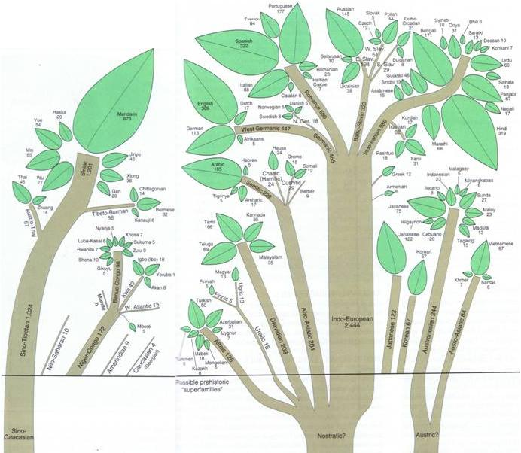
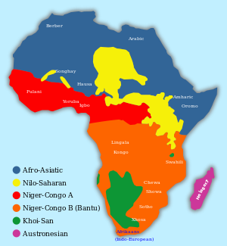
I. Language families and dialects
C. languages are “living” and change over time, then die out ,latin is an example of a dead language
D. scientists classify languages into language families or groups of related languages
  1. Indo-European languages of India + Europe, largest language family
  2. Sino-Tibetan languages of eastern Asia
  3. bantu languages of sub-Saharan Africa (Niger congo family)

Slide 4

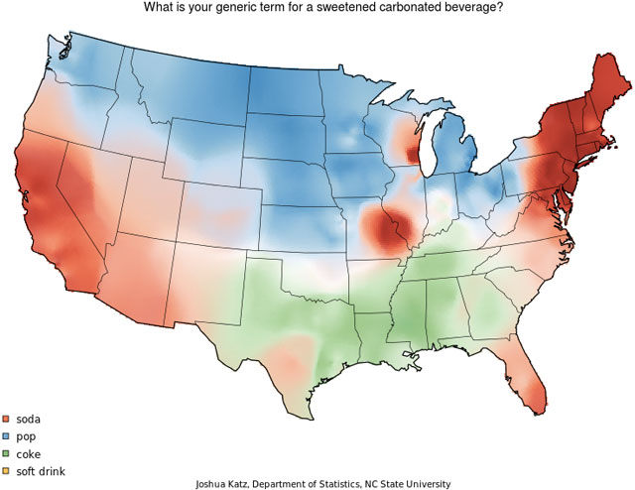
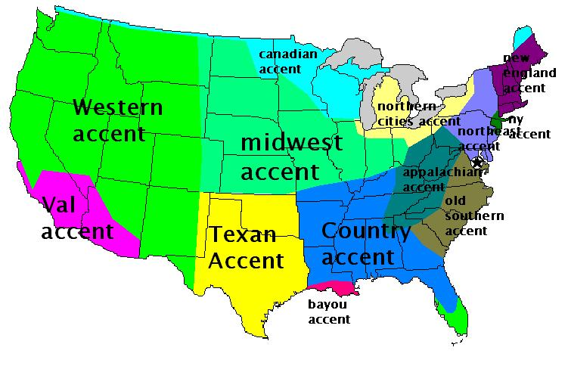
II. Common terms used in connection with languages
A. linguistics means the study of languages
B. linguists believe that all modern languages are derived from one original language
C. a dialect is a local variation of a language, also sometimes called an accent
D. many languages use ideograms, a symbol or a picture that represents a word or a thought
III. The future of languages.
A. Linguists believe that 90% of all languages will die out in the next 100 years

