Slide 1
Polygamy and Utah’s Struggle for Statehood
Objective: Students will be able to understand the obstacles Utah had to overcome in order to become a state

Slide 2
Why Become a State?
Rights of citizenship
Represented in national government
Elect their own leaders
Pay taxes, in exchange receive government services
Freedoms of citizenship

Slide 3
4 Obstacles
Size and borders of state
Polygamy
Conflicts with Native Americans
Conflicts with US Government

Slide 4
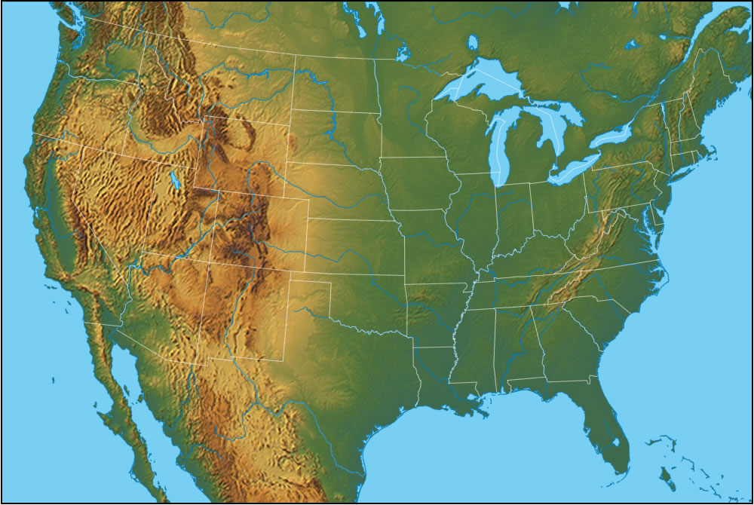
Size and Borders
Class Brainstorm: If you had to draw the borders of a western state, what resources and geographical features would you include?

Slide 5
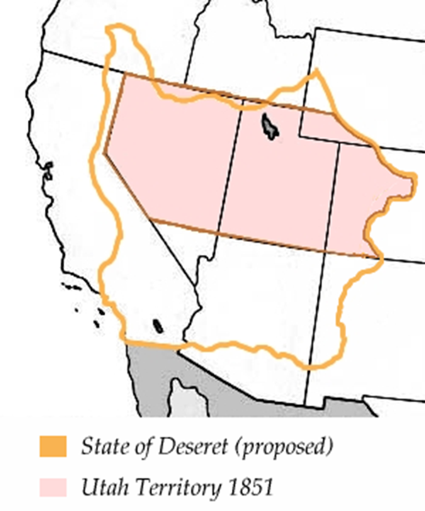

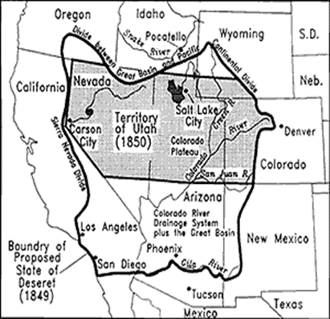
Obstacle 1 : Size and shape - 1850
State of Deseret
  Brigham Young wanted the land to be dedicated
  State motto: industry
  Inspire Mormons to be productive, hard working people, like a beehive
  State covered 16% of the nation. http://www.history.com/topics/us-states/utah/videos/how-utah-got-its-shape

Slide 6
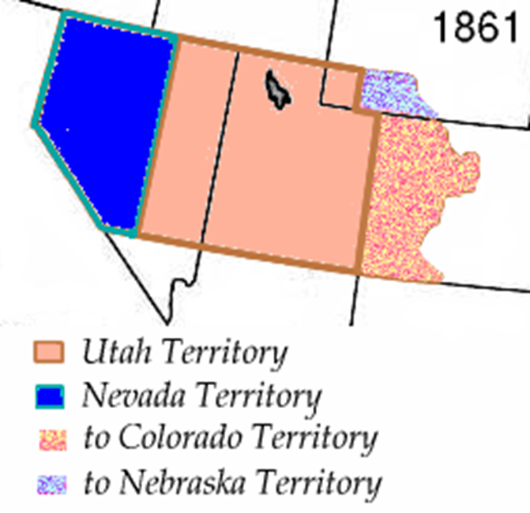
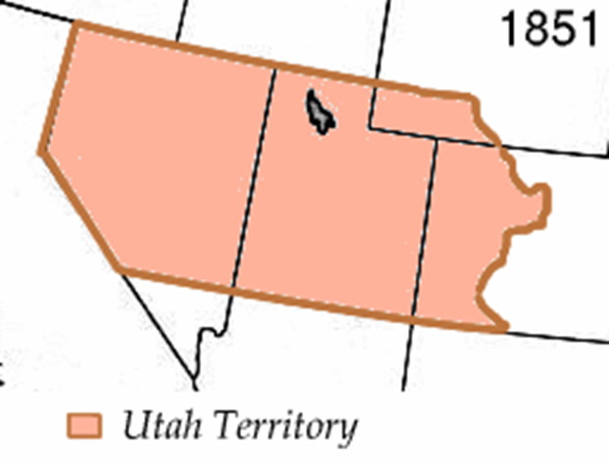
Utah Territory

Slide 7
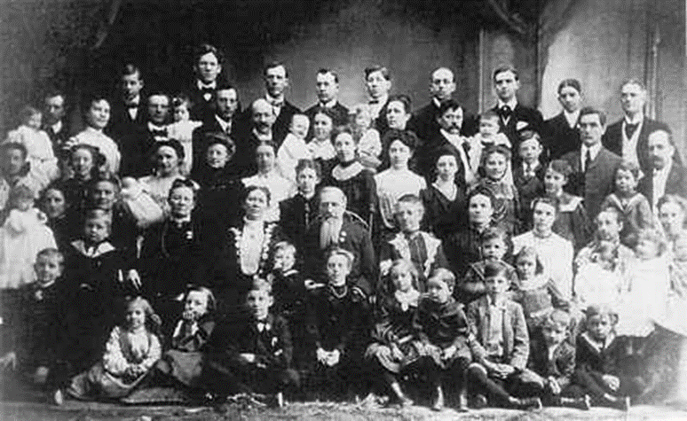
Obstacle 2: Polygamy - 1852
Conflicts between Church and State
Mormon reasoning:
  Commandment of God
  Repopulate the Earth
US Government view:
  Strange, unconstitutional, blemishes America
  Enslaving women to men?
  Pressures Mormons to abandon practice

Slide 8
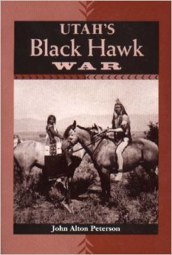
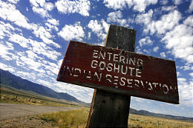
Obstacle 3: Native Americans – 1850s and 1860s
As Mormons settled in the Salt Lake Valley, conflict begins with disrupting Native American trade routes
Conflict with displaced Utes increased in The Walker War (1853-54) and Black Hawk War (1863-68)
The federal government moved to remove Indian claimed lands to expedite statehood.
As a result, many natives were forced to live on tribal reservations

Slide 9
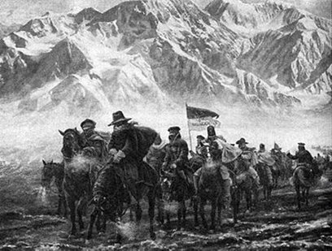

Obstacle 4: US Government – 1857
“Utah War”: Utah and Federal Government1857 to 1858
  Not a true “war”. No official battles, instead war of words
  President Buchanan heard rumors of rebellion in Utah, sent Johnson’s army to end it
  War was avoided and tensions eventually died
Massacre at Mountain Meadows - September 1857
  Due to tensions over war, and massive fear of outsiders, Utahn’s attacked and killed 120 immigrants headed west to California

Slide 10
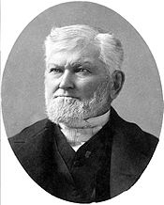
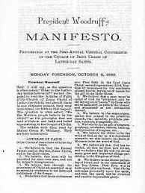
Obstacle 5: Manifesto - 1890
Morrel anti bigamy law
Congress passes Edmunds-Tucker Bill—confiscate LDS property, and take away women’s right to vote.
Mormon leaders begin drafting a state constitution to align with federal laws against polygamy.
Church leader Wilford Woodruff announces his Manifesto, doing away with polygamy, thus allowing statehood.

Slide 11
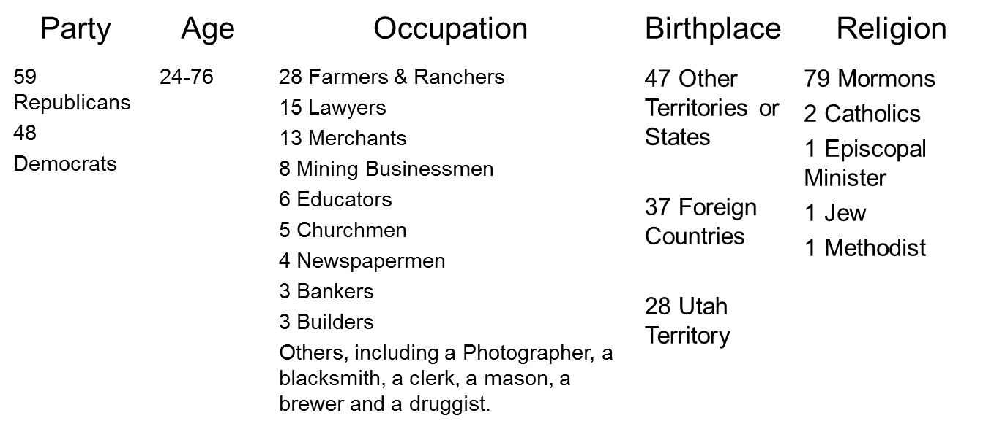
Authors of Utah’s Constitution
Draw Conclusions:
  What were some of the prominent jobs of the writers of the constitution?
  What does that say about the values of Utah?

Slide 12
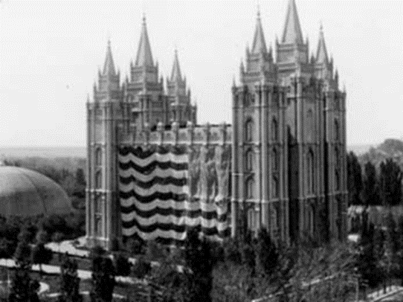
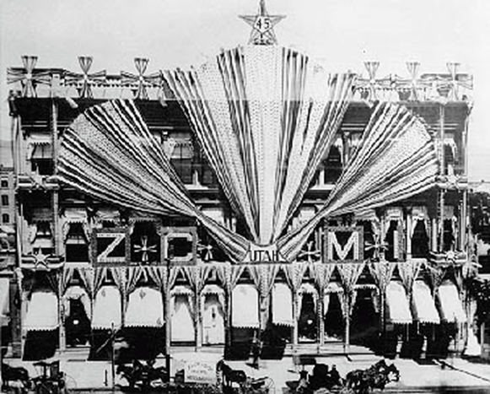

State of Utah - 1896
January 4th 1896
Utah becomes 45th state!

Slide 13
Timeline in Review
1850: Utah First applies for statehood. It is denied.
1850: U.S. Congress establishes Utah territory. Brigham Young is appointed as first governor.
1852: The LDS Church officially announces the practice of polygamy, when one man is married to multiple women.
1857-1858: “Utah War” begins. Johnson’s armies are sent from the east. Mountain Meadows Massacre
1861: Outbreak of the Civil War in the South. Johnson’s army leaves Utah.
1869: Utah’s women gain suffrage (the right to vote). In 1887 it is taken away until the 19th amendment allows all women to vote.
1896: Utah becomes the 45th state!

