Slide 1
Great Depression through Many Sources

Slide 2
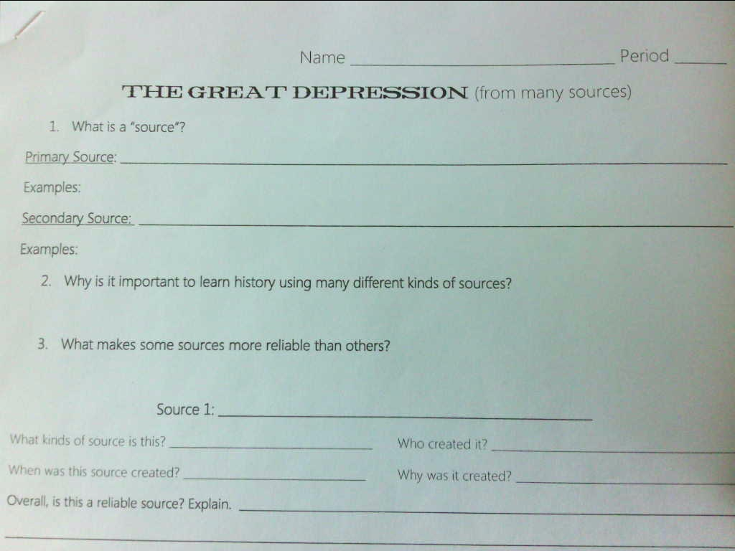

Slide 3
Primary source:
What is a source?
Something you can get information from
Source created by someone who saw or was involved in the actual event
Source created at the time an event happens, or soon after

Slide 4
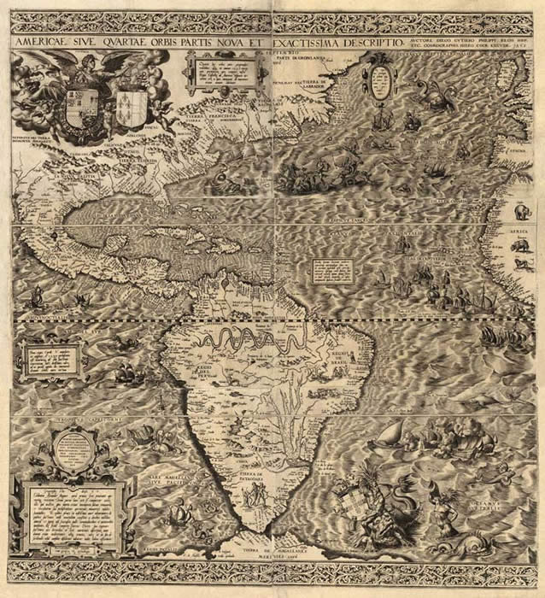
What are examples of primary sources?
Maps

Slide 5
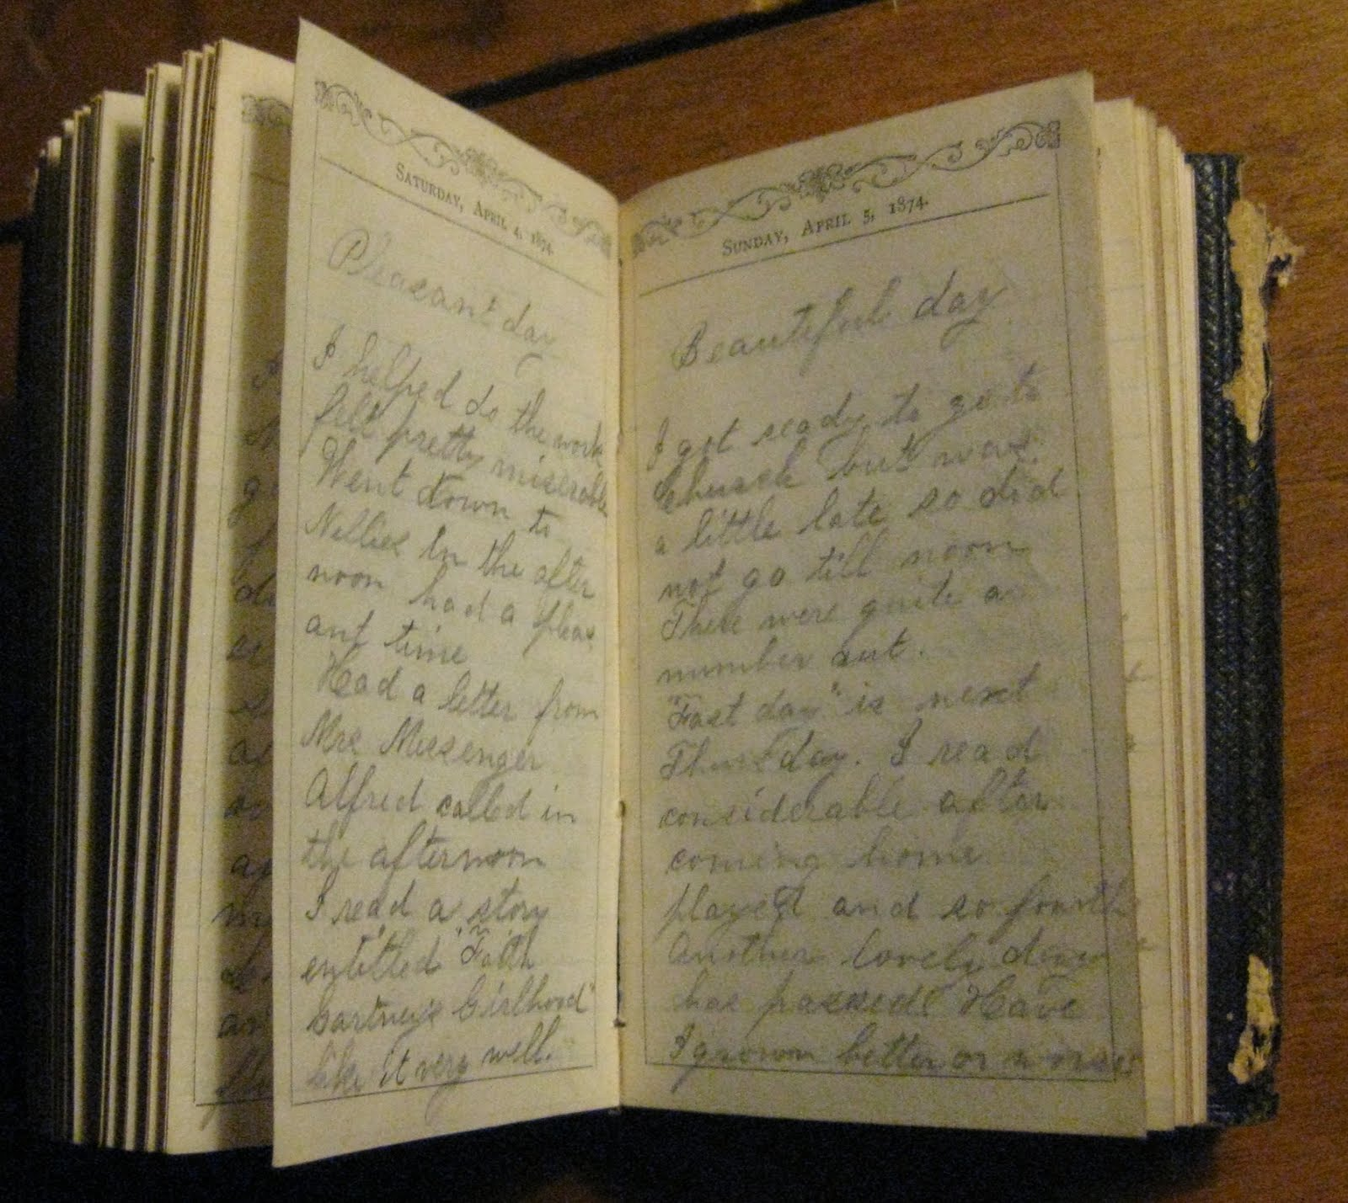
What are examples of primary sources?
Maps
Diaries

Slide 6
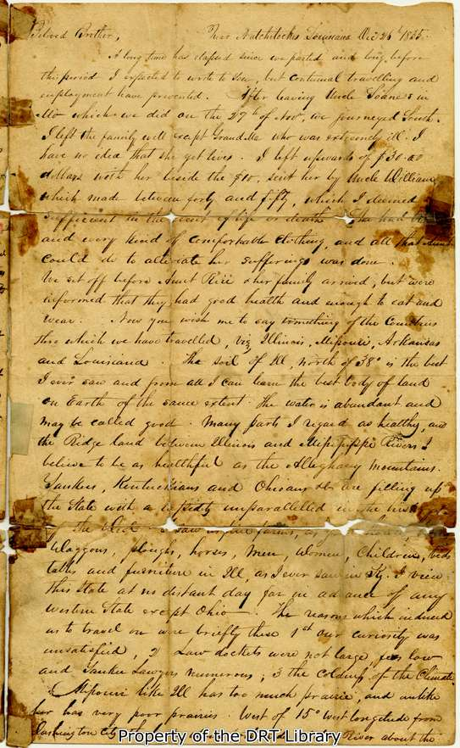
What are examples of primary sources?
Maps
Diaries
Letters

Slide 7
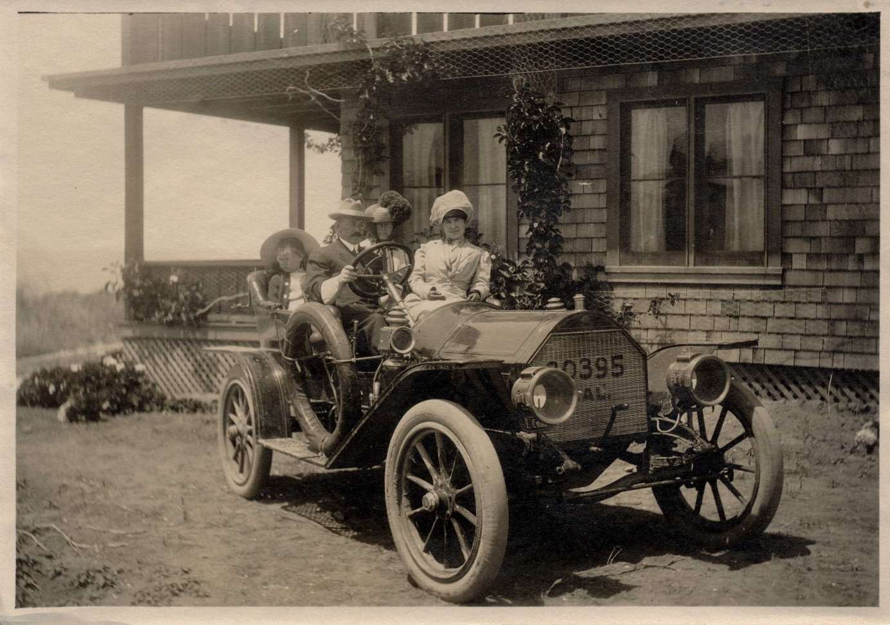
What are examples of primary sources?
Maps
Diaries
Letters
Photos

Slide 8
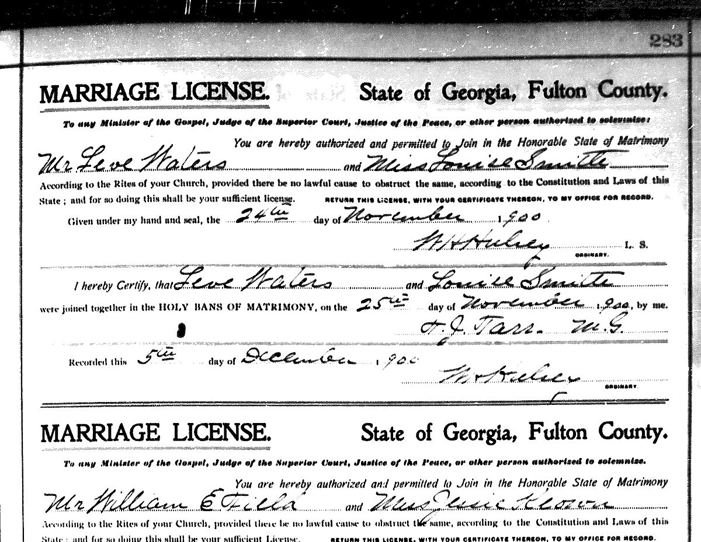
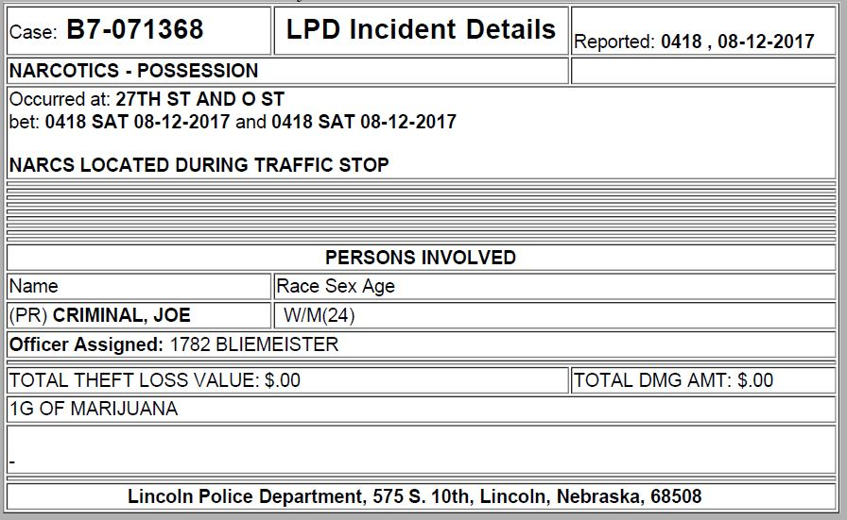
What are examples of primary sources?
Maps
Diaries
Letters
Photos
Documents

Slide 9
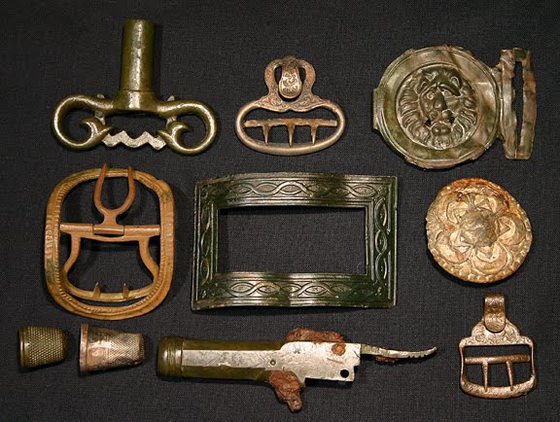
What are examples of primary sources?
Maps
Diaries
Letters
Photos
Documents
Artifacts

Slide 10
A thousand years from now in the year 3018, historians are trying to find out what life was like in the year 2018☺
List some primary sources that would tell historians about what life was like today

Slide 11
What is a secondary source?
A secondary source uses primary sources to give information about an event
Examples:
  Textbooks
  Papers/articles written by scholars
  (websites, Wikipedia, and encyclopedias are usually tertiary sources because they use secondary sources to give information about an event)

Slide 12
Source 1: Utah Journey
What kind of source is it: Textbook
Who created it: Historians
When was it created: 2009
Why was it created: To educate students

Slide 13
Source 2: Peggy Eaton Story
What kind of source is it: Journal/Diary; Primary Source
Who created it: Peggy Eaton
When was it created: 1935
Why was it created: To tell her story about her experience in the Depression

Slide 14
Source 3: What life was like during the Great Depression
What kind of source is it: Secondary
Who created it: Errol Uys
When was it created: various
Why was it created: To explain what life was like during the Depression

Slide 15
Source 4-12: Photos
What kind of source is it: Primary Sources
Who created it: Photographers
When was it created: During the Depression
Why was it created: To show what was happening in people’s lives

Slide 16
Source 13: A young Peoples History of the United States
What kind of source is it: History Text
Who created it: Howard Zinn
When was it created: 2007
Why was it created: To educate

Slide 17
Source 15: America: The Story of Us - BUST
What kind of source is it: Documentary
Who created it: History Channel
When was it created: 2010
Why was it created: To entertain and educate

Slide 18
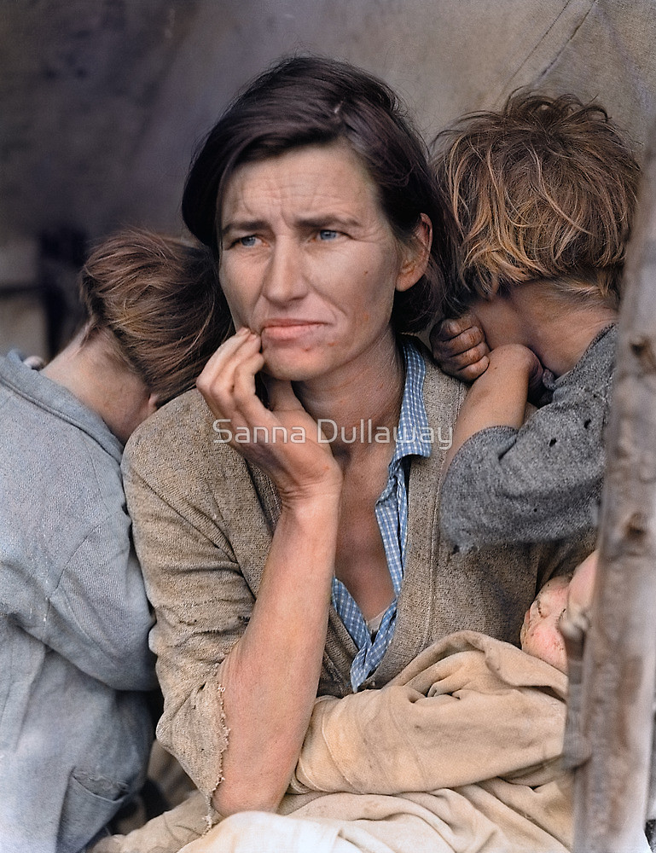
Source 4

Slide 19
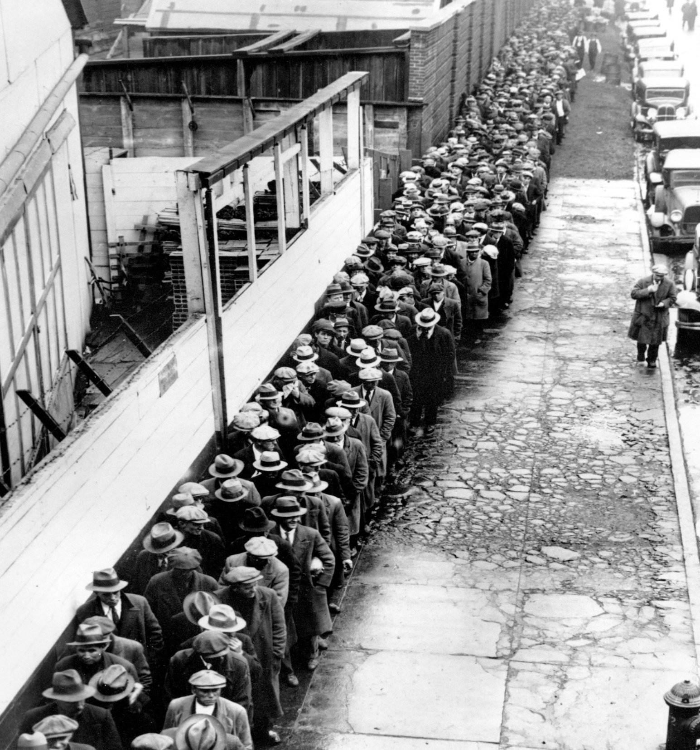
5

Slide 20
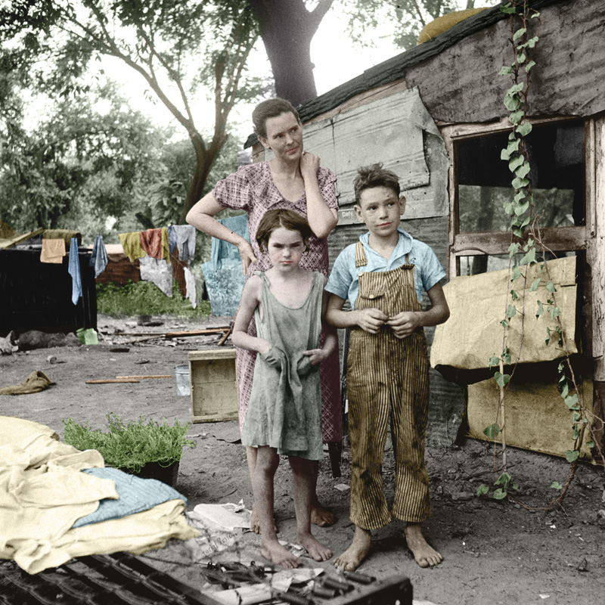
6

Slide 21
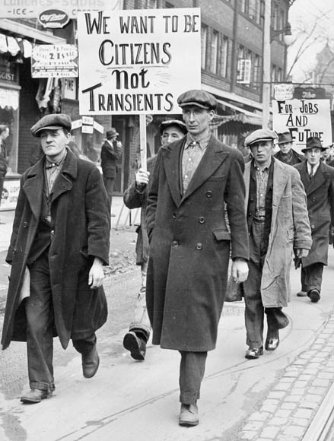
7

Slide 22
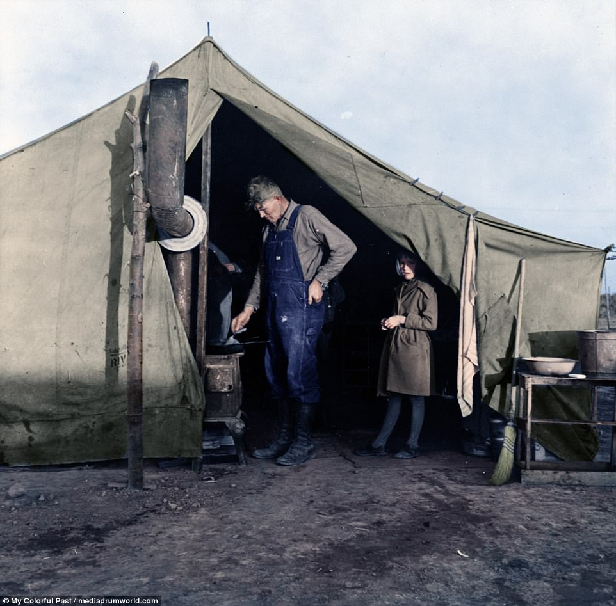
8

Slide 23
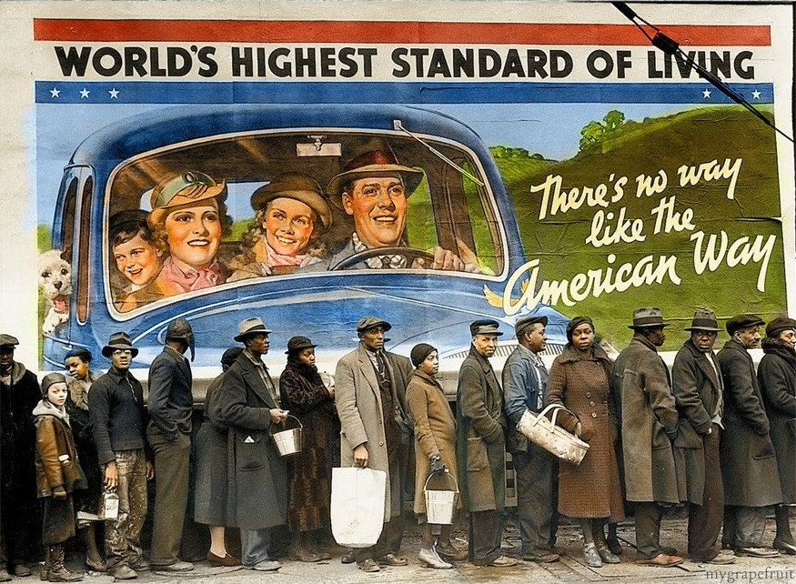
9

Slide 24
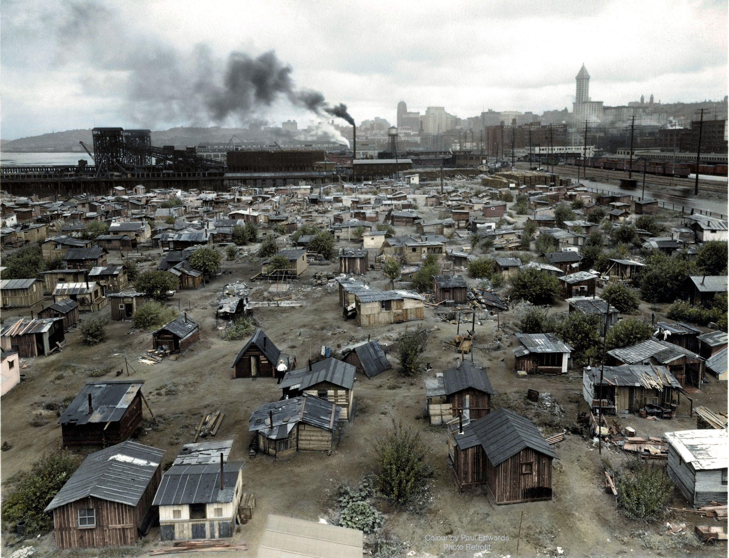
10

Slide 25
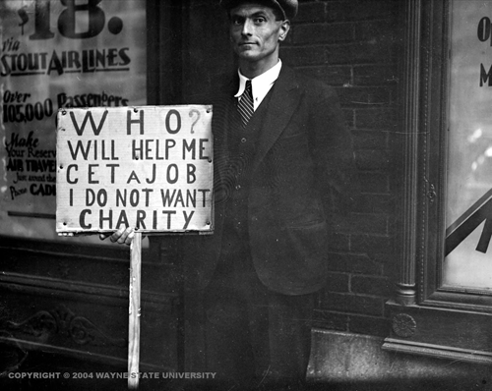
11

Slide 26
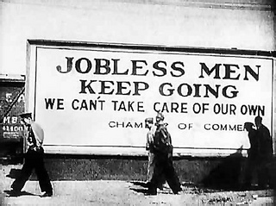
12

Slide 27
Essay instructions….
    At the bottom write “all 4 paragraphs must have clear topic sentences.”

