Slide 1
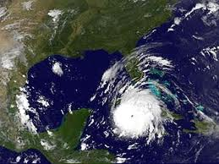
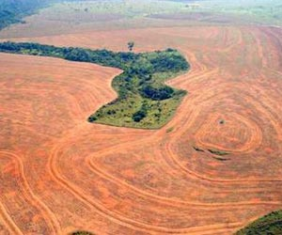
5 Themes- Human/Environment Interaction
Mrs. Helquist

Slide 2

Terms to know for test
-Pollution
-Deforestation
-Desertification
-Acid Rain
-Endangered Species
-Global Warming
-Human/Environment Interaction

Slide 3

Questions to answer for the test
-What is pollution? Give and example of pollution.
-How have humans changed the environment?
-Why is the theme of human/environment interaction important?
-How does the changing of environment impact your life?

Slide 4
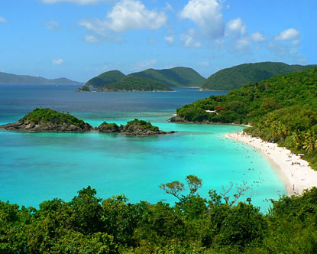
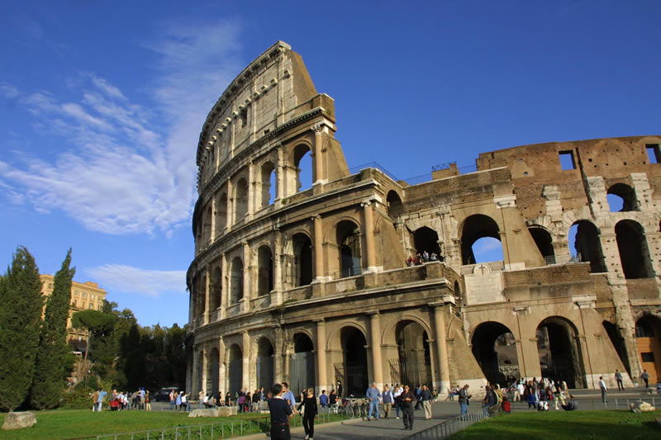

I. The Theme of Geography- Human/Environment Interaction.
A. The theme of Human/Environment Interaction answers the question, “How do humans change and/or adapt to the environment”.
B. People are attracted to certain places and environments for several reasons:
  1. Climate, Weather
  2. Geography, Terrain
  3. Culture (Music, Food, Religion)

Slide 5
I. The Theme of Geography- Human/Environment Interaction.
C. Each place on the earth has distinct advantages and disadvantages.
D. People generally modify their environments to meet their needs.
  1. Deforestation- Removal or destruction of tree cover.
  2. Desertification- Degradation of land from human activities.
  3. Endangered Species- Population of an organism in risk of extinction.
  4. Disease- Condition of an organism, impairs bodily function and/or is deadly.

Slide 6
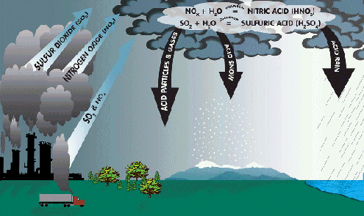
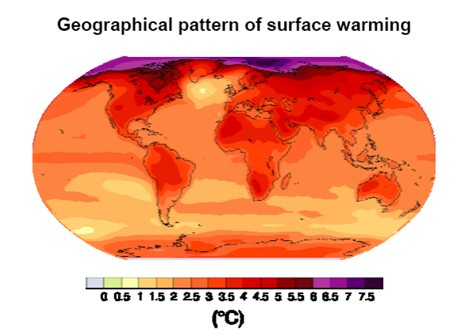
I. The Theme of Geography- Human/Environment Interaction.
E. An important environmental term is pollution, the introduction of contaminants into an environment that cause instability, disorder, harm, or discomfort to a physical system.
  1. Acid Rain- Any form of precipitation that is unusually acidic.
  2. Global Warming- Increase in average temperature of the earth’s near-surface air and oceans.

