Slide 1
Population Notes

Slide 2
Population
The science of demographics is the study of populations.
The term population simply means how many people are there?
Population is not evenly distributed, people group where there are the most resources.

Slide 3
D. A major statistic is population density or the number of people per square mile.
E. The birth and death rates are how many people are born or die per 1000 people.
F. Whereas, infant mortality rate measures how many babies die before their first birthday per 1000 births.
G. The rate of natural increase is the percentage at which a countries population is increasing
(how many more people are born than die)

Slide 4
The differences between developed and undeveloped world countries.
A Developed country is one that has wealth, education, good government, technology, etc.
They generally have low birth rates and low death rates.
This is because children are an economic burden. Also, people tend to live longer
Examples include the U.S., Canada, Japan, U.K., Australia

Slide 5
The differences between developed and undeveloped world countries.
E. A Undeveloped country is one that lacks wealth, has Little technology, and a lack of standard resources etc.
F. They generally have high birth rates and high death rates.
G. This is because children are an economic asset and they don’t have the means to keep people alive.
H. Examples- most of Africa (Kenya), Haiti, Afghanistan

Slide 6
Rules
You can not say the word
Raise your hand when you and your partner know the world

Slide 7
Demography

Slide 8
Death Rate

Slide 9
Developed country

Slide 10
Switch

Slide 11
Birth Rates

Slide 12
Undeveloped country

Slide 13
Rate of Natural increase

Slide 14
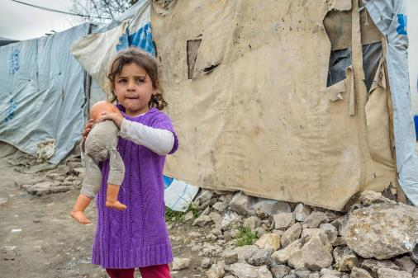
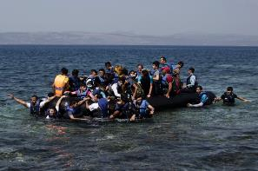
Population/Migration Day 2

Slide 15
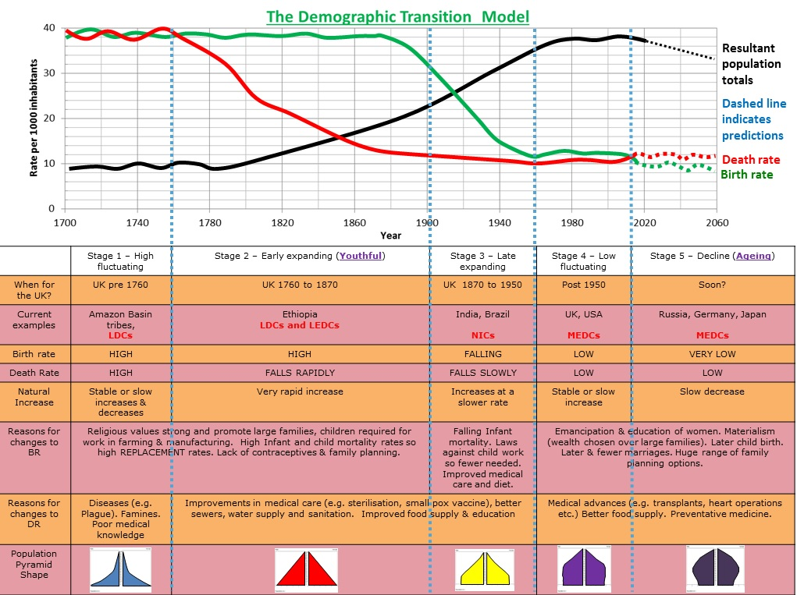
Part I A. the demographic transition model (DTM) explains the transition from high birth and deathrates to low birth and deathrates as a country develops

Slide 16
Part II Migration terms
B. An Immigrant is: a person who comes to a country to take up permanent residence.
C. an Emigrant is: A person who exits a country to take up residence elsewhere.
D. typically Emigrants are leaving countries Lower on the Demographic Transition model and immigrating to countries in higher stages.
E. Voluntary Migrant is a person relocating according to personal desires such as: economic reasons/ searching for a better life/ climate/healthcare( most migrants are Voluntary)

Slide 17
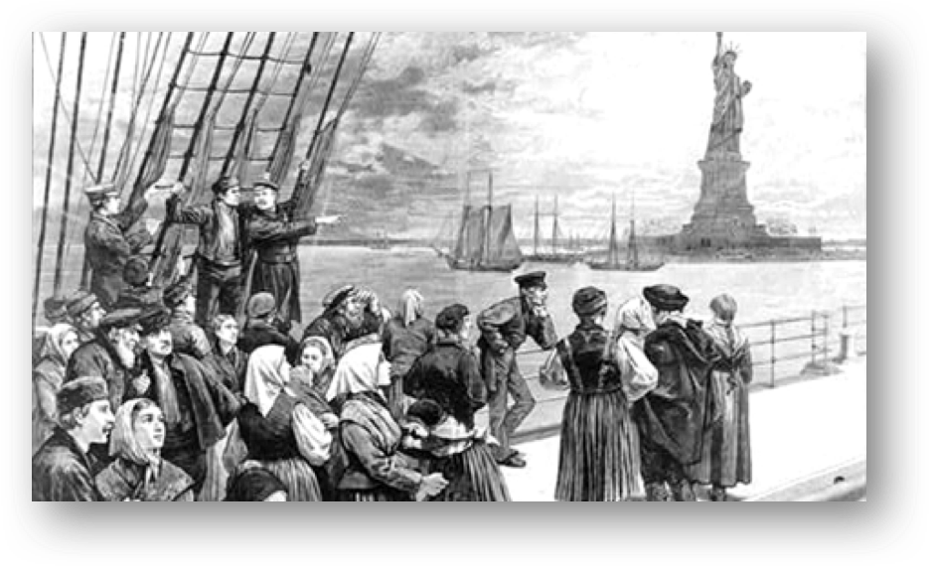

Immigrants at Ellis Island
Immigration Citizenship test

Slide 18
Part II Cont’d
F. Forced Migration Involuntary movement when the migrant has no choice but to relocate.
  1. Internally Displaced Person (IDP): someone who is forced to flee his or her home but who remains within their country’s borders.( Such as: Trail of tears, Hurricane Harvey )
  2. Refugee: Someone forced to flee his or her home and leaves their country. ( Such as: Middle east, Cuban refugee)
  3. Slavery: when people are forcefully removed from their living circumstance and bought and sold like property.(Such as Colonial Slavery, Forced marriages)

Slide 19
Trail of Tears
Hurricane Harvey Houston

Slide 20
Part III Reasons people migrate
G. Push Factors reasons people leave an area
(such as climate factors, loss of jobs, pollution etc.)
H. Pull Factors reasons people come to an area (such as education, jobs, climate, culture, politics)
Part VI Migrant Locations
I. Rural area located outside of towns and cities with low population density .
J Urban area located within towns and cities with high population density.
K. Urbanization migration from rural villages to urban cities resulting in large population growth in those cities.

