Slide 1
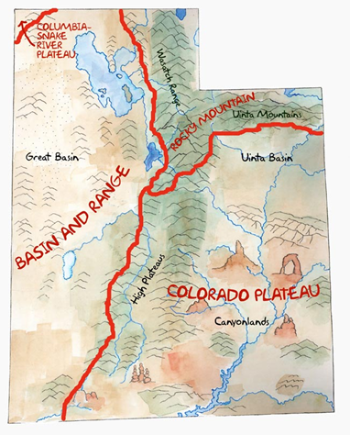
Regions of Utah
Step 1: Title: “Regions of Utah”
Step 2: Label each section:
  “Basin and Range”,
  “Columbia-Snake River Plateau”
  “Great Basin”
  “Wasatch Range”
  “High Plateaus”
  “Rocky Mountain”,
  “Uinta Mountains”
  “Uinta Basin”
  “Colorado Plateau”
  “Canyonlands”
Step 3: Draw mountains along the line dividers (color green)
Step 4: Draw Utah Lake, Bear Lake, and Lake Powell (color blue)
Step 5: Draw Rivers (color blue)
Step 6: Draw arches and plateaus (color brown)
Step 7: Include key and compass rose

