Slide 1
Utah’s Natural Resources

Slide 2
Natural Resource
Natural = existing in nature and not made or caused by people.
Resource = something that a country or place has that can be used to increase wealth
Natural Resource = materials supplied by the earth that can be used to increase wealth
  examples include: plants, animals, minerals and fresh air.

Slide 3
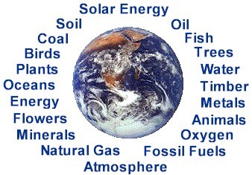
Natural Resource

Slide 4
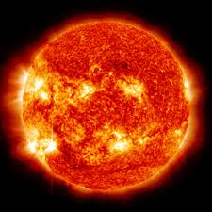
Perpetual Resource
Resources that we have an unlimited amount of

Slide 5
Renewable Resource
A resource that keeps coming back.
  The wind and the sun are renewable resources

Slide 6
Non-renewable Resource
Opposite of renewable resources- resources that we have now but once used will not be available again.
Examples include coal and oil.

Slide 7
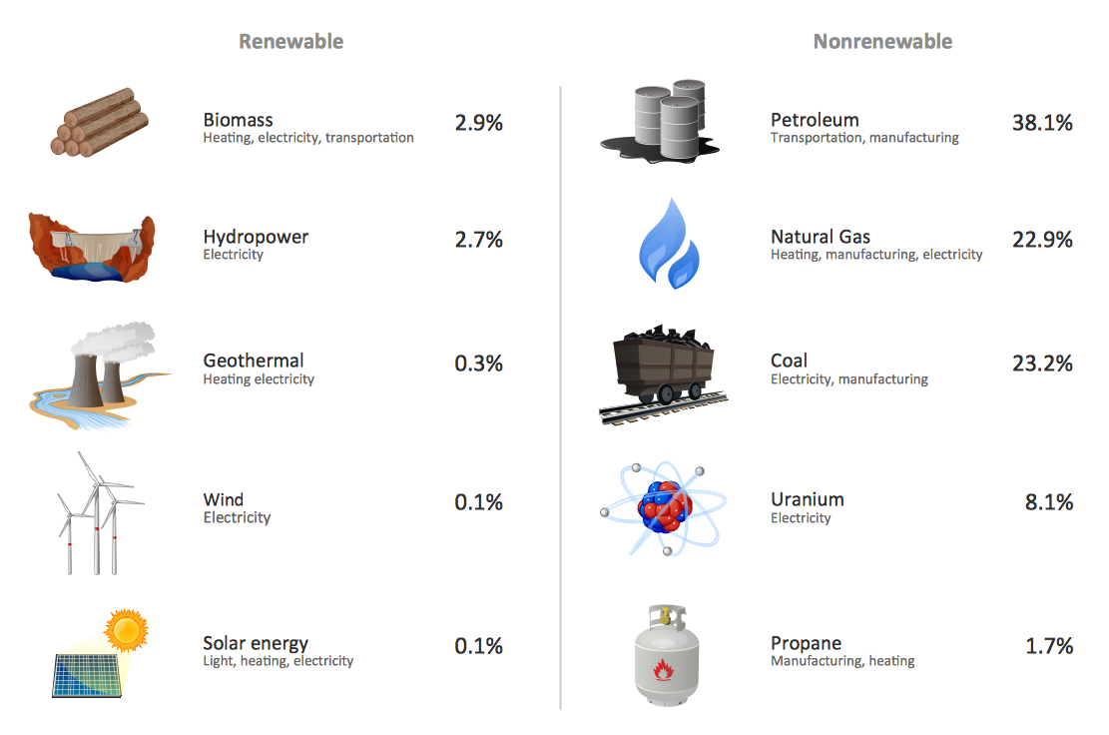
Non-renewable VS renewable Resource

Slide 8
Potential Resource
A Resource that we don’t know how to use as a resource yet.

