Slide 1
CARTOGRAMS

Slide 2
WHAT ARE THEY?
CARTOGRAMS TAKE MAPS AND SUBSTITUTE LAND AREA OR DISTANCE FOR ANOTHER VARIABLE.
TO MAKE A CARTOGRAM YOU NEED TO LOOK AT ANY MEASURABLE STATISTIC FOR A PLACE.
FOR EXAMPLE: TAKE A LOOK AT THE UNITED STATES DURING THE 2004 PRESIDENTIAL ELECTION.

Slide 3
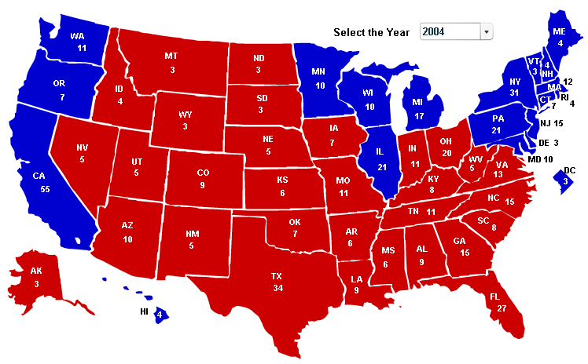
YOU CAN JUST PUT THE NUMBERS OF VOTES IN EACH STATE:

Slide 4
OR YOU COULD GIVE EACH ELECTORAL VOTE ONE SQUARE ON A GRID. THEN YOU CAN EASILY SEE WHERE THE MOST VOTES CAME FROM.

Slide 5
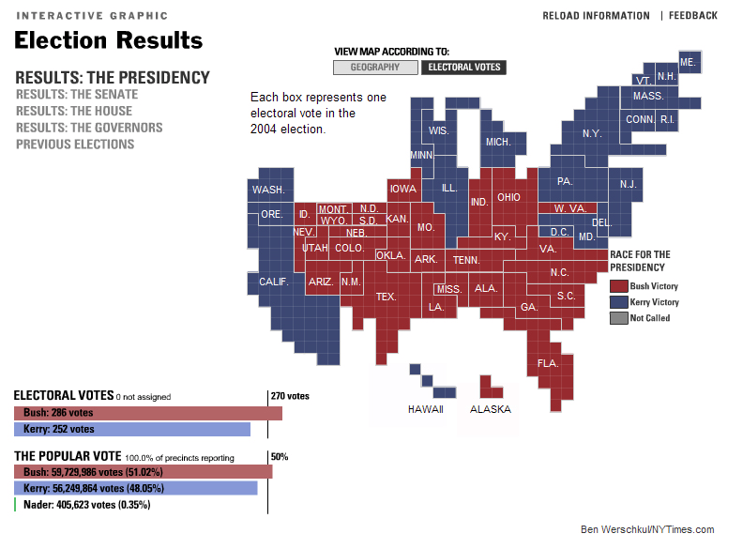

Slide 6
HERE ARE MORE EXAMPLES.

Slide 7
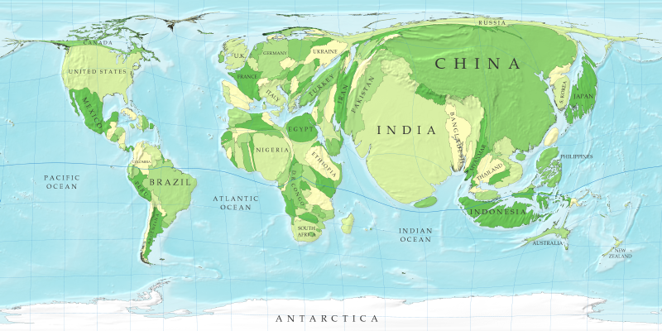
WORLD POPULATION

Slide 8
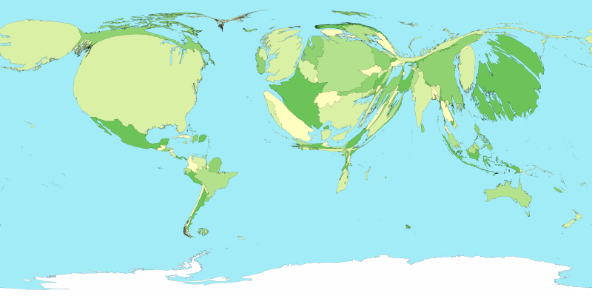
GDP

Slide 9
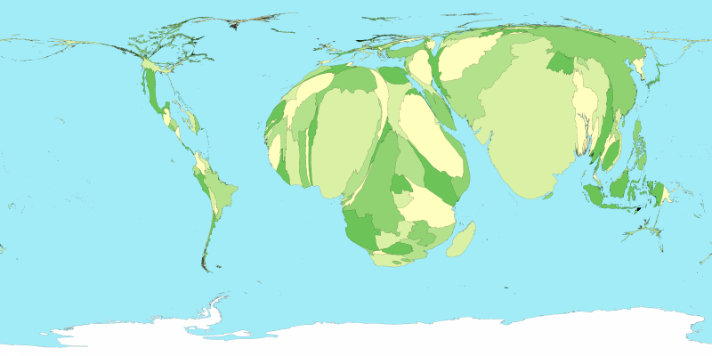
CHILD MORTALITY

Slide 10
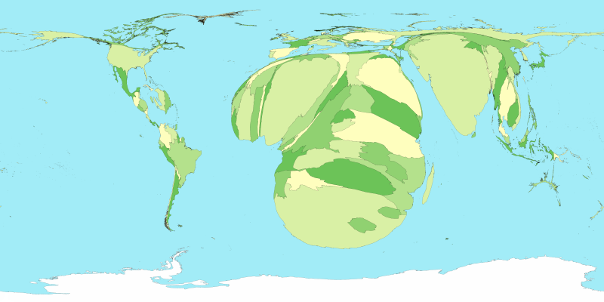
HIV/AIDS

Slide 11
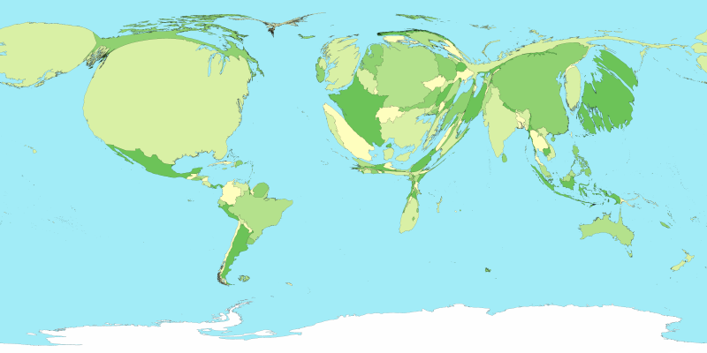
HEALTH CARE SPENDING
ALL IMAGES FROM:
HTTP://WWW-PERSONAL.UMICH.EDU/~MEJN/CARTOGRAMS/

Slide 12
NOW USE THE POPULATION STATISTICS PROVIDED AND CREATE A CARTOGRAM OF SOUTH AMERICA.
EACH SQUARE ON THE GRAPH SHEET SHOULD EQUAL ONE MILLION PEOPLE.
  SOME COUNTRIES DON’T HAVE A MILLION PEOPLE. USE HALF A SQUARE TO REPRESENT A HALF A MILLION.
KEEP THE COUNTRIES IN THE SAME ORDER SO IT IS STILL RECOGNIZABLE.

Slide 13
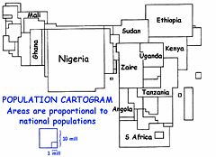
HERE IS HOW IT MIGHT LOOK IF YOU MADE A CARTAGRAM OF AFRICA USING THOSE SAME INSTRUCTIONS.

