Slide 1

Totalitarianism-
Absolute Rule

Slide 2

Different Types
I. Totalitarianism is a political system which the state, under control of a single political organization regulates everything (dictatorships etc.)
II. Authoritarianism is a totalitarian system that is controlled by non-elected rulers who usually permit some individual freedom (china communist party)
III. Monarchy
  A. a monarchy is a government led by a king or queen
  B. monarchies are generally hereditary (passed down by blood)
  C. there are two types of monarchies:
    1. absolute monarchy: one person rules
    2. constitutional monarchy: power is shared between a king and democratic government
  D. countries with monarchies today include Saudi Arabia, U.k., morocco, tonga, u.a.e.

Slide 3
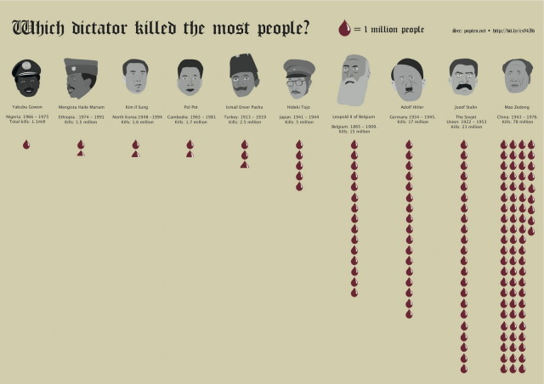
IV. dictatorship
A. dictator is a person who assumes sole and absolute power
B. a dictator usually comes to power in a time of crisis through a military coup (armed forces take over)
C. a dictator’s goal is generally maintain and spread total power over a region

Slide 4

V. fascism
A. fascism is a system where one party runs the government like a company (fascist Italy and nazi Germany)
B. fascism often relies on legal segregation in housing, resource allocation and employment

Slide 5
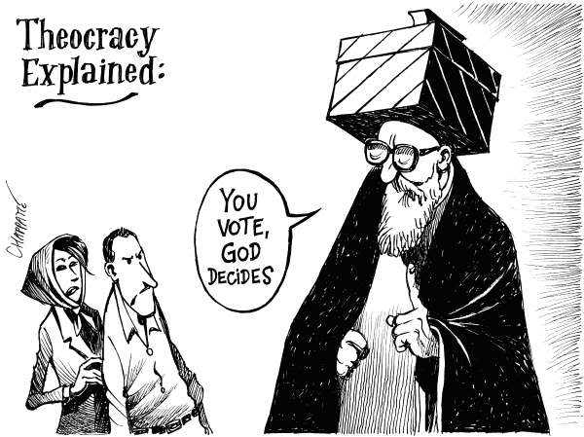
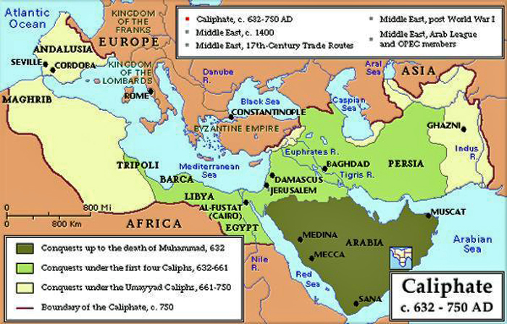
Vi. Fundamentalist theocracy
A. these systems base control on religious law and order, caliphates are countries following Islamic law and order
B. examples today include Iran, Vatican city, Saudi Arabia etc.

