Slide 1
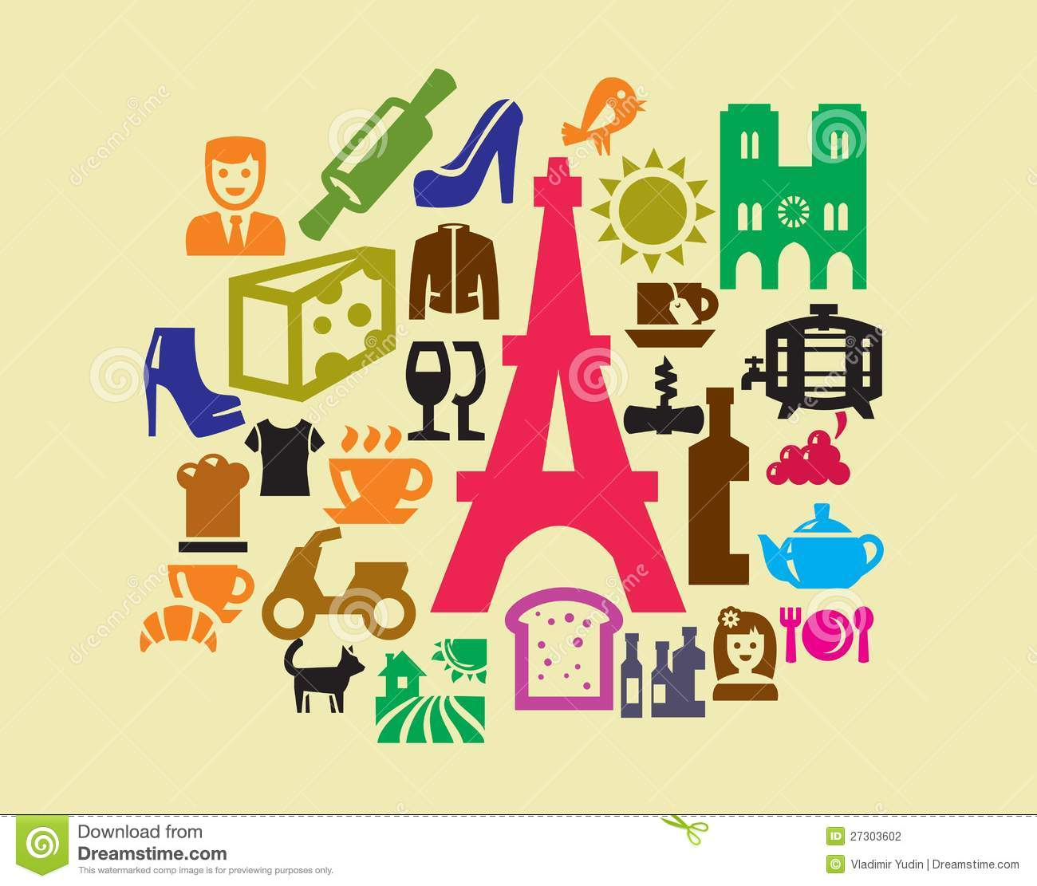
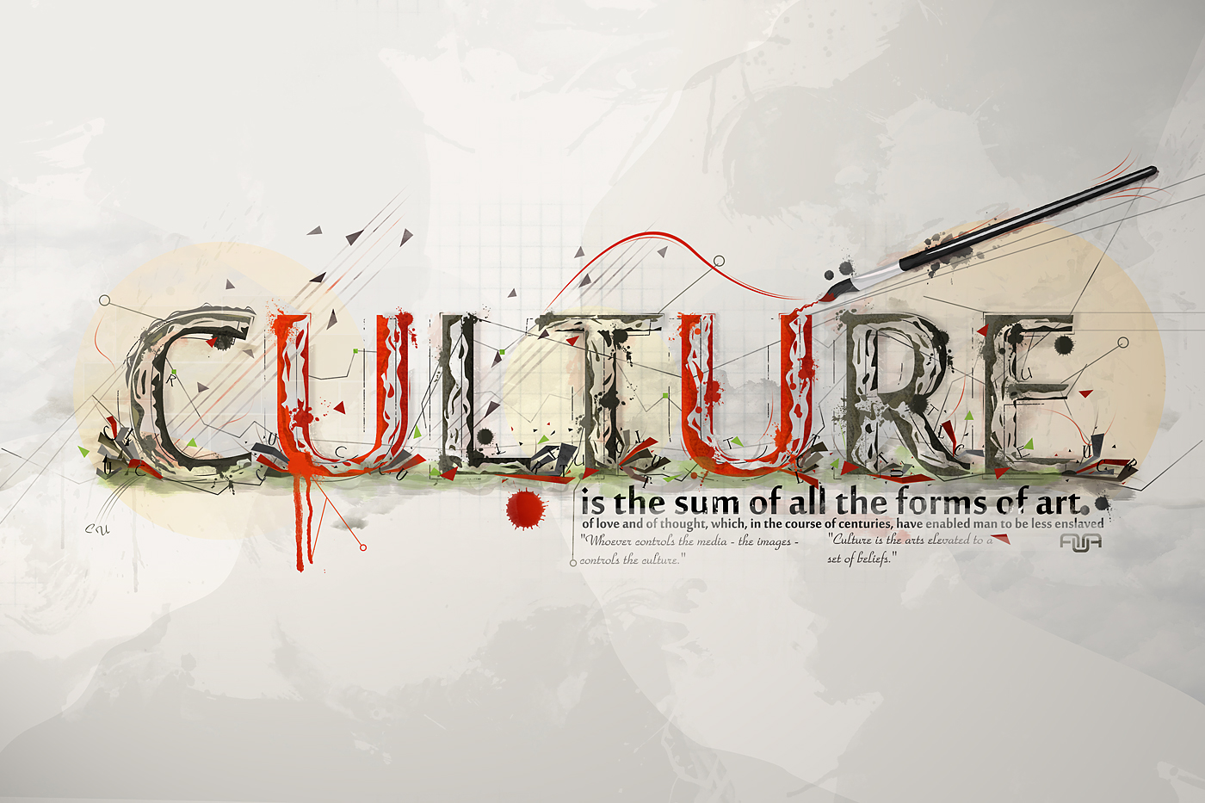
Culture and Culture Expressions

Slide 2
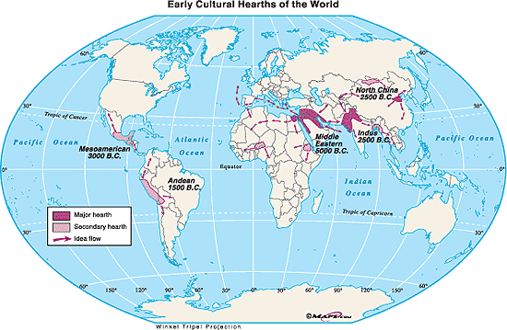
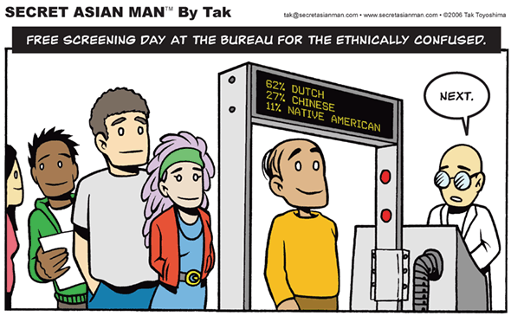
I. Culture and its origins
A. Culture is a persons way of life and identity and includes religion, food, politics, clothing, music, holidays, traditions, sports etc.
B. Culture hearths are places on earth that first developed and recorded culture and include china, india, Egypt, Mesopotamia.
C. an ethnic group is a group of people that share a common culture.
D. ethnic groups should not be confused with race or a group of people who share common physical features.

Slide 3
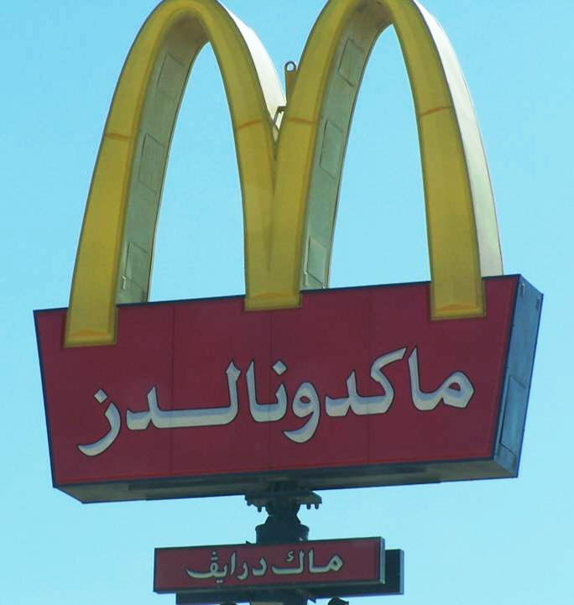
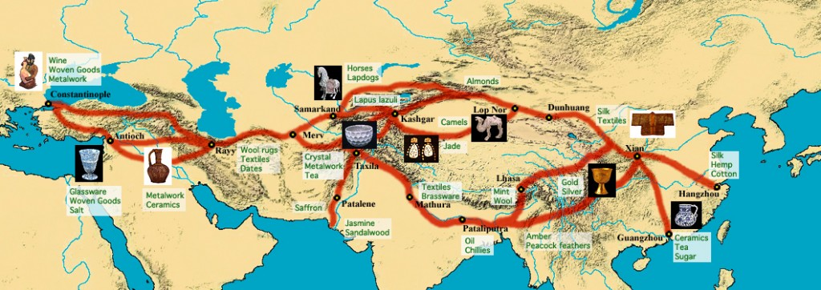
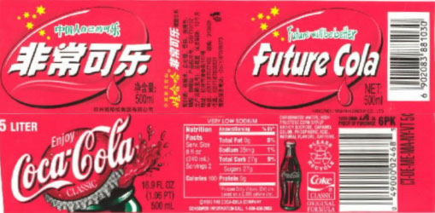
II. The spreading and mixing of culture
A. Cultural diffusion is when culture spreads to new areas or mixes with other cultures.
B. cultures come in contact most often by trading, or by war.
C. Barriers to cultural diffusion include oceans, mts, deserts, but today the main barrier is prejudice.
D. Culture spreads today because of the media, television, internet, music etc.
E. No culture can be considered to be pure or unique.
F. today you often hear the words multicultural: a person or group that has more than one culture, and cultural pluralism when a whole country or society has many different cultures within it.

Slide 4
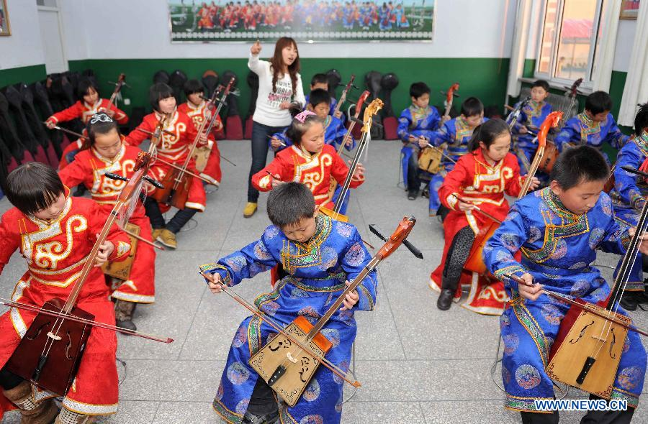
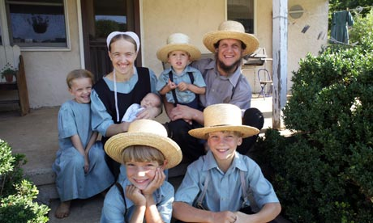
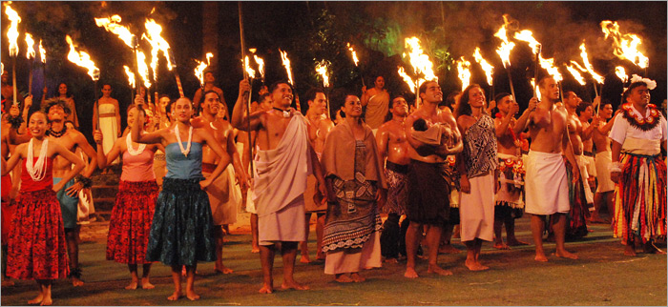
Folk V pop Culture
G. Folk Culture: Traditions practiced typically in isolation by small groups of people. (Amish/rural china etc)
H. Pop Culture: Cultural activities, practices and products reflected or suited to general masses of people in a society. (United States/western Europe)

Slide 5
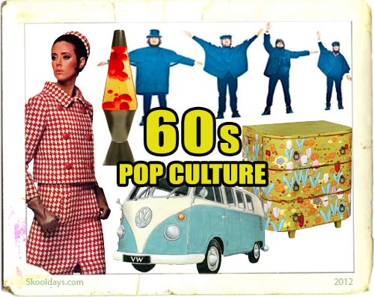
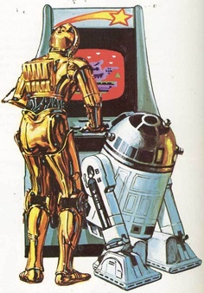
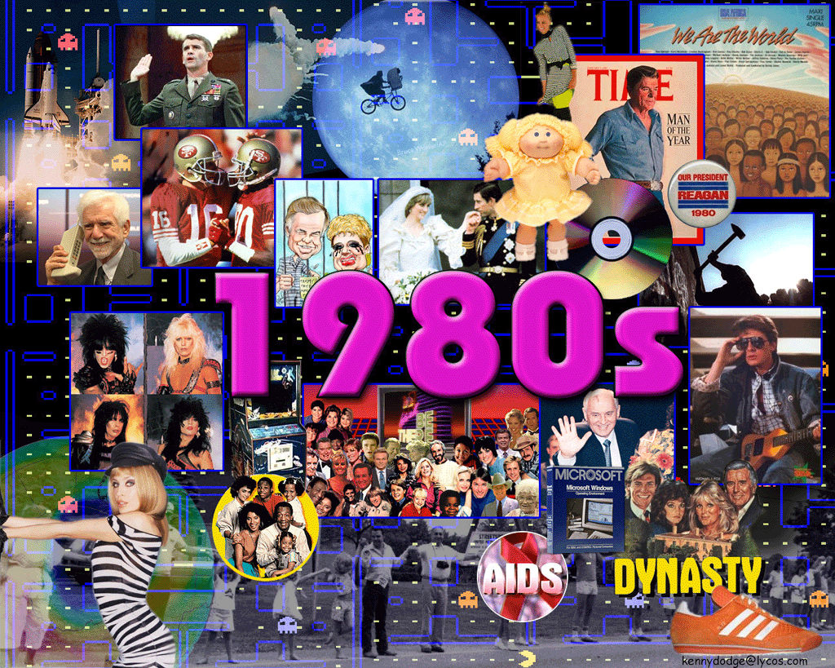
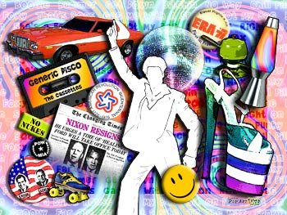
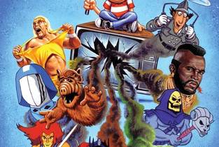
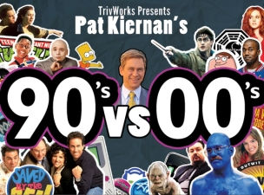
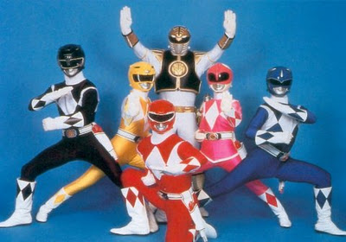
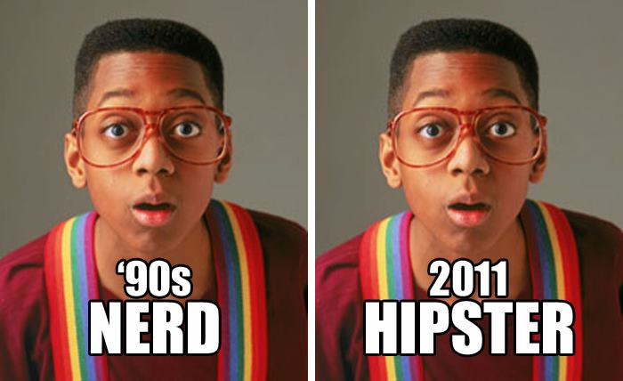
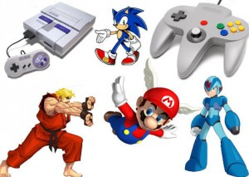


Slide 6

