Slide 1
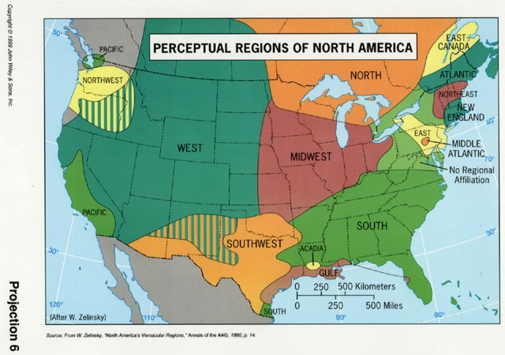
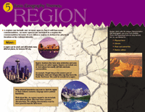
The Five Themes of Geography- Region
Mrs. Helquist

Slide 2
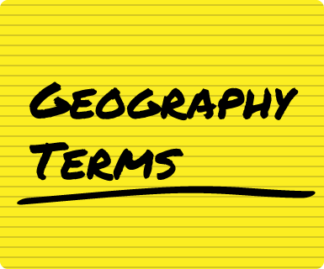
Terms to know for your test:
- Region
- Formal Region
- Functional Region

Slide 3

Questions to answer for the test:
How does a functional region differ from a formal region?
How is the theme of region helpful to us?
What regions could the United States, Utah, and Herriman be part of?

Slide 4
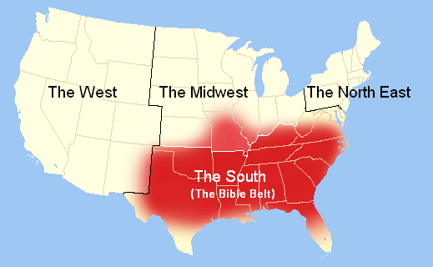
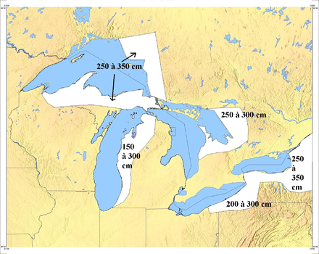
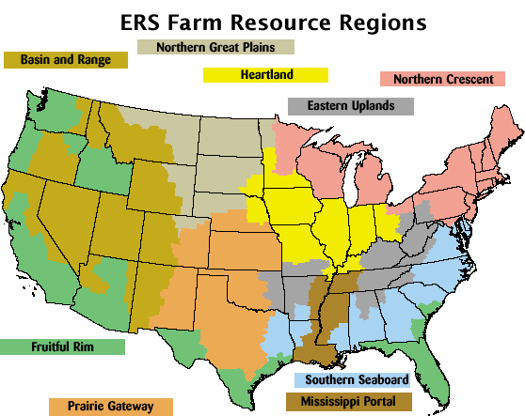
I. The Fifth Theme of Geography- Region
A. The theme region answers the question, “how is this place similar and different from other places?”
B. One of the two main types of regions are formal regions, an area that shares a common characteristic.
  1. Examples include the Midwest, for farming.
  2. The Middle East, Muslim religion.
  3. The islands of Polynesia, common culture.
  4. Formal regions can be based on physical features, cultural features, common resources etc.

Slide 5
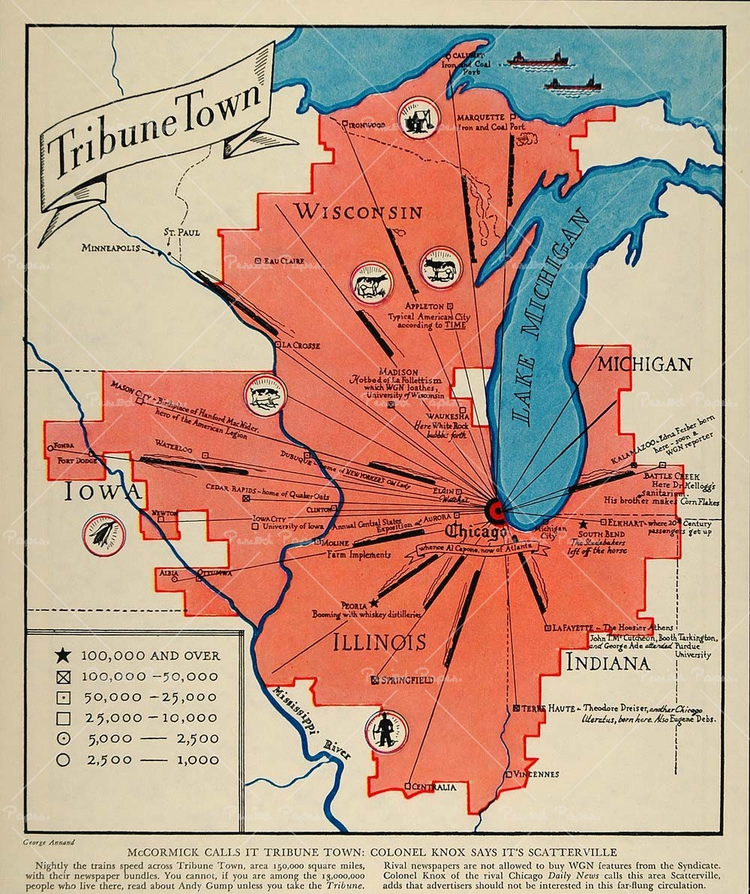
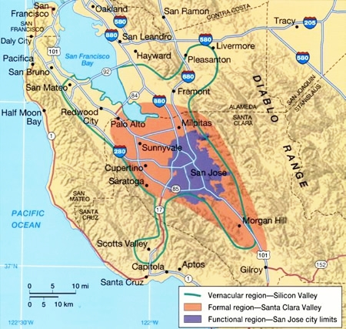
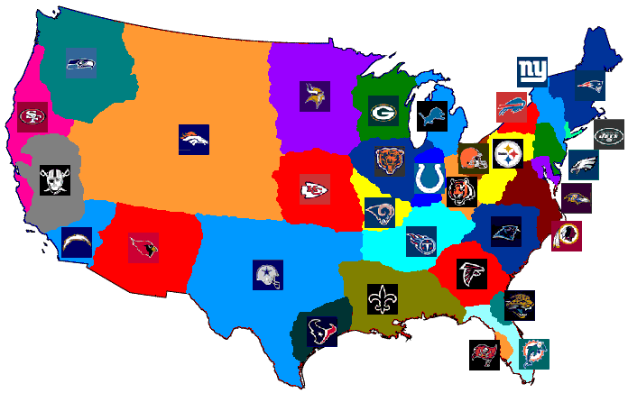
I. The Fifth Theme of Geography- Region
C. The other type functional regions, an area with a central or hub city with the outlying areas which depend on it.
  1. Examples might include the Wasatch Front for recreation, mining, lumber etc.
  2. The Ruhr Valley in Germany for the economic center of Germany.
  D. People create regions to help organize their world, they can be as small as a neighborhood or cover thousands of miles.

