Slide 1

The Five Themes of Geography- Movement
Mrs. Helquist

Slide 2

Terms to know for your test:
-Movement
-Interdependence
-Cultural Diffusion

Slide 3
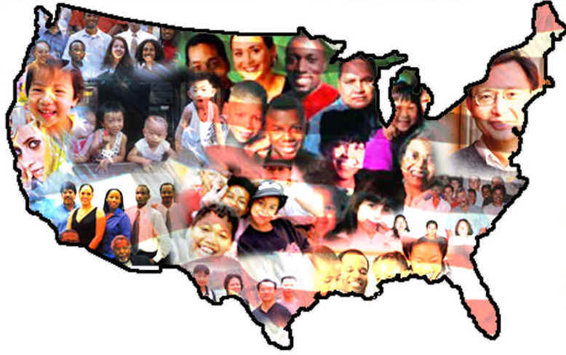
Questions to answer for test:
What is interdependence? Give an example of how the U.S. and the world are interdependent.
Why is the theme of movement important?
How has the movement of ideas, people, and goods impacted your life?

Slide 4
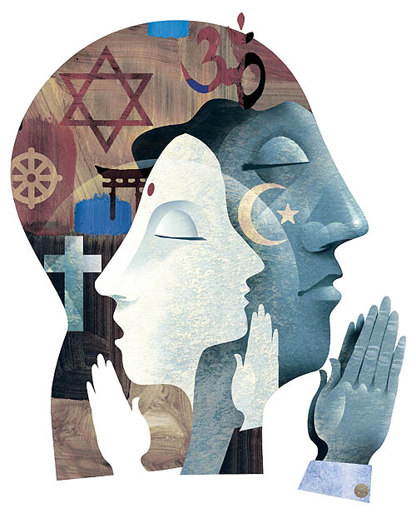
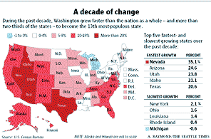
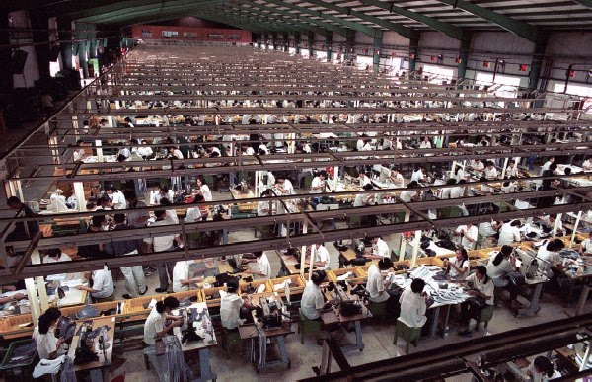
I. The Third Theme of Geography- Movement
A. The theme movement answers the question, “How are places connected to other places?”.
B. There are many kinds of things that move from place to place:
  1. People (Immigration/Emigration)
  2. Goods (Imports/Exports)
  3. Ideas (Culture, Religion, Trends)

Slide 5
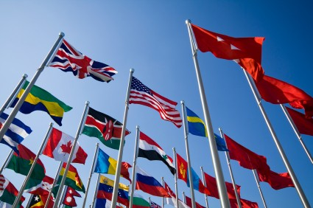
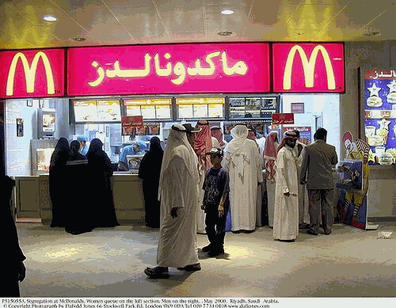
I. The Third Theme of Geography- Movement
C. People generally move because of things such as war, economy, oppression.
D. An important geographic term is cultural diffusion, the spreading and mixing of cultures.
E. An important part of movement in geography is interdependence, the reliance on one another socially, economically, environmentally, and politically.

