Slide 1
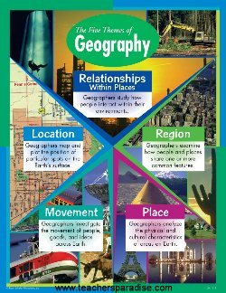

Five Themes of Geography: Location
Mrs.Helquist

Slide 2
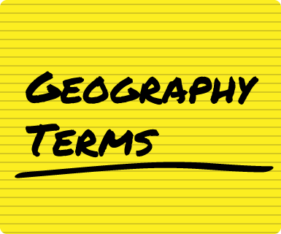
Terms to know for your test:
Location
Latitude (parallels)
Longitude (meridians)
Absolute Location
Relative Location
Geography
Grid System

Slide 3

Questions to answer for test:
What is geography?
What do people use to find absolute location?
Why is the theme of location important?
In what ways do we use relative and absolute location in our everyday lives?

Slide 4
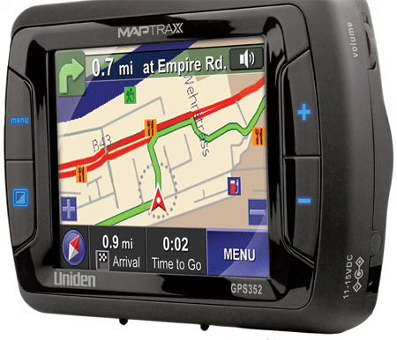
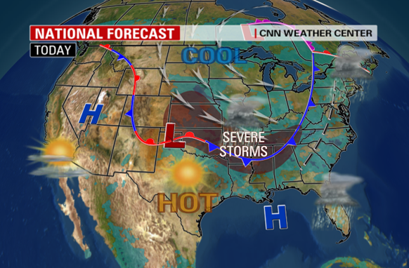
I. Welcome to Geography!
A. Geography is “the why of where”, or why things are where they are.
B. We use geography everyday, such as:
  1. Planning routes, using maps, GPS, GIS etc.
  2. Getting dressed, planning days activities
  3. Recreation, obtaining resources

Slide 5
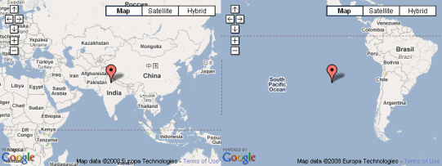
II. The First Theme of Geography - Location
A. The theme location answers the question, Where?
B. There are two types of location we can use:
  1. Absolute location, it’s exact position on the globe.
  2. Relative location, it’s location relative to other places.

Slide 6
Example
https://www.youtube.com/watch?v=tyrbyOPYlfU
Absolute Locations uses exact location and Gps runs off of it.
  An example of this is…. Washington DC 38 N 77 W
Relative Location of give us the general direction of place and is sometimes identified often by landmarks around it
  An example of relative location is St. George is South of Herriman
  What’s another example: Write down your example

Slide 7
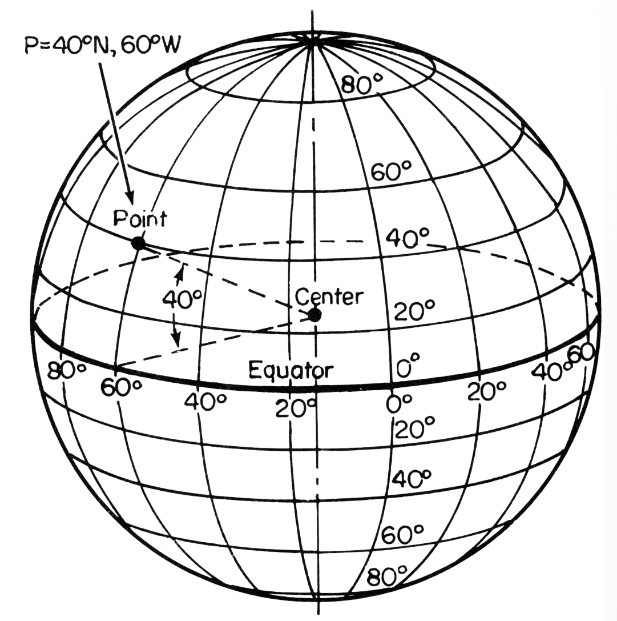
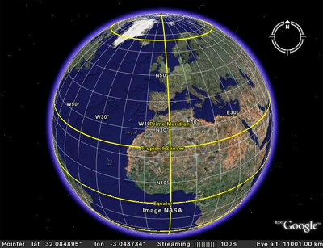
II. The First Theme of Geography Location
C. Geographers use imaginary lines to find absolute location:
  1. Latitude (parallels) lines measure distance north and south of the Equator.
  2. Longitude (meridians) lines measure distance east and west of the Prime Meridian.
  3. Together they form the grid system, this allows the location of a point on a map to be described in a way that is universally understood.

Slide 8
Latitude/Longitude song
https://www.youtube.com/watch?v=MjDqhLUzCpE

Slide 9
Starter
Why is the theme of location important?
Do you use relative or absolute location more in your daily life, why do you think that is?
What is the difference between physical and human features?

Slide 10
Terms to know for your test:
Key/legend
Political map
Projections
Compass rose
Physical map
Absolute location
Scale
Special purpose map
Relative location
Latitude
Longitude
Cardinal directions

Slide 11
Questions to answer
Explain the main part of map
When would a person need a physical map?
Why is it important to know how to use different kinds of maps?

Slide 12
Parts of map
Maps answers the first question or theme of Geography Location.
The key or legend explains map symbols or colors.
The compass rose shows a set of pointers that show direction.
The cardinal directions are the four main directions North, South, East, & West.

Slide 13
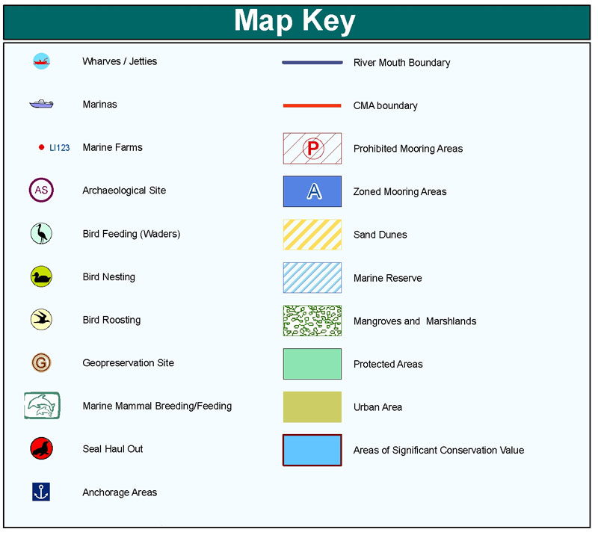
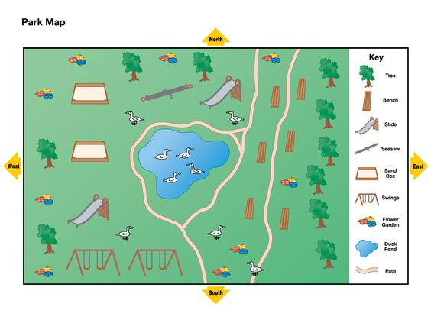
Example

Slide 14
The Scale shows the relationship of real distance on earth to the distance on the map
The lines of latitude and longitude are imaginary lines used to measure degrees in a circle North and south, East and west.
Latitude runs Horizontal but measures North and south.
The equator is an imaginary line that divides the earth in to Northern and Southern Halves.

Slide 15
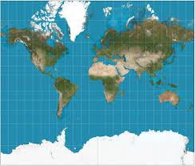
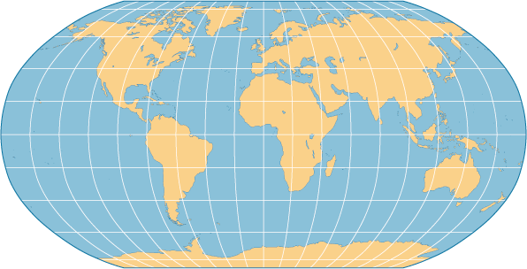
Longitude runs vertical but measures East and West.
The Prime Meridian is the imaginary line that helps divide the earth into Eastern and Western Halves.
Maps come in different projections or distortions depending on what the map is trying to show.

Slide 16
Different Kinds of Maps
A political map shows color to show different countries, states, and other political features.
A physical map shows physical features such as elevation and physical features.
A special purpose map shows specific special data such as population or types of monster.

